Slide 1
JavaScript ES5
05 May 18 | Start
06 May 18 | 57
16 May 18 | 9: 106-111
16 May 18 | 6: 83:90
18 May 18 | 1: 3-34
18 May 18 | 3:62-73
21 May 18 | 3:74-80
23 May 18 | 17: 301-314
25 May 18 | 17: 315-321
21 Jun 18 | 3:81-88
03 Jul 18 | 3: 89-92
Appendix
Online

Slide 2
JS ES5
Ch | Date
1 | 05 May 18
2 | 06 May 18
3
4
5
6
7
8
9
10
11
12
13
14
15
16
17
JavaScript ES5 - The Definitive Guide 04 2011

Slide 3
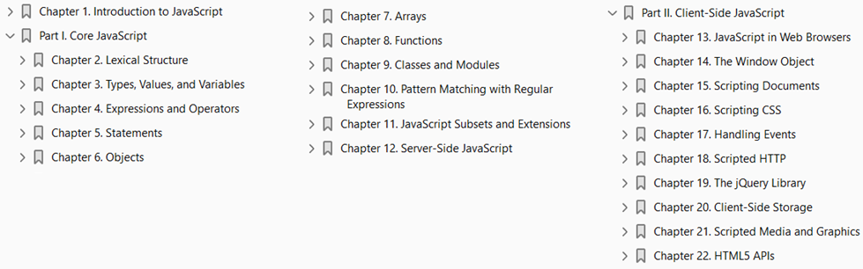

Slide 4
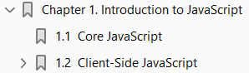
1
Introduction to JavaScript

Slide 5
Intro
JavaScript is the programming language of the Web.
The overwhelming majority of modern websites use JavaScript, and all modern web browsers—on desktops, game consoles, tablets, and smart phones—include JavaScript interpreters, making JavaScript the most ubiquitous programming language in history.
JavaScript is part of the triad of technologies that all Web developers must learn:
HTML to specify the content of web pages
CSS to specify the presentation of web pages
JavaScript to specify the behavior of web pages.
This book will help you master the language.
If you are already familiar with other programming languages, it may help you to know that JavaScript is a
high-level
Dynamic
Untyped
Interpreted
programming language that is well-suited to object-oriented and functional programming styles.

Slide 6
Syntax
JavaScript derives its syntax from Java,
its first-class functions from Scheme
its prototype based inheritance from Self
But you do not need to know any of those languages, or be familiar with those terms, to use this book and learn JavaScript.
The name “JavaScript” is actually somewhat misleading.
Except for a superficial syntactic resemblance, JavaScript is completely different from the Java programming language.
And JavaScript has long since outgrown its scripting-language roots to become a robust and efficient general-purpose language.
The latest version of the language (see the sidebar) defines new features for serious large-scale software development.

Slide 7
JavaScript: Names and Versions
JavaScript was created at Netscape in the early days of the Web, and technically, “JavaScript” is a trademark licensed from Sun Microsystems (now Oracle) used to describe Netscape’s (now Mozilla’s) implementation of the language.
Netscape submitted the language for standardization to ECMA—the European Computer Manufacturer’s Association—and because of trademark issues, the standardized version of the language was stuck with the awkward name “ECMAScript.”
For the same trademark reasons, Microsoft’s version of the language is formally known as “JScript.”
In practice, just about everyone calls the language JavaScript.
This book uses the name “ECMAScript” only to refer to the language standard.
For the last decade, all web browsers have implemented version 3 of the ECMAScript standard and there has really been no need to think about version numbers: the language standard was stable and browser implementations of the language were, for the most part, interoperable.
Recently, an important new version of the language has been defined as ECMAScript version 5 and, at the time of this writing, browsers are beginning to implement it.
This book covers all the new features of ECMAScript 5 as well as all the long-standing features of ECMAScript 3.

Slide 8
JavaScript: Names and Versions |
When we’re speaking of the language itself, the only version numbers that are relevant are ECMAScript versions 3 or 5. (Version 4 of ECMAScript was under development for years, but proved to be too ambitious and was never released.)
Sometimes, however, you’ll also see a JavaScript version number, such as JavaScript 1.5 or JavaScript 1.8.
These are Mozilla’s version numbers:
version 1.5 is basically ECMAScript 3
later versions include nonstandard language extensions (see Chapter 11)
Finally, there are also version numbers attached to particular JavaScript interpreters or “engines.”
Google calls its JavaScript interpreter V8, for example, and at the time of this writing the current version of the V8 engine is 3.0.

Slide 9
API
To be useful, every language must have
a platform or
standard library or
API of functions
for performing things like basic input and output.
The core JavaScript language defines a minimal API for working with
Text
Arrays
Dates
regular expressions
but does not include any input or output functionality.
Input and output (as well as more sophisticated features, such as networking, storage, and graphics) are the responsibility of the “host environment” within which JavaScript is embedded.
Usually that host environment is a web browser (though we’ll see two uses of JavaScript without a web browser in Chapter 12).

Slide 10
Book Structure
Part I of this book covers the language itself and its minimal built-in API.
Part II explains how JavaScript is used in web browsers and covers the sprawling browser-based APIs loosely known as “client-side JavaScript.”
Part III is the reference section for the core API. You can read about the JavaScript array manipulation API by looking up “Array” in this part of the book, for example.
Part IV is the reference section for client-side JavaScript. You might look up “Canvas” in this part of the book to read about the graphics API defined by the HTML5 <canvas> element, for example.
This book covers low-level fundamentals first, and then builds on those to more advanced and higher-level abstractions.
The chapters are intended to be read more or less in order.
But learning a new programming language is never a linear process, and describing a language is not linear either: each language feature is related to other features and this book is full of cross-references—sometimes backward and sometimes forward to material you have not yet read.
This chapter makes a quick first pass through the core language and the client-side API, introducing key features that will make it easier to understand the in-depth treatment in the chapters that follow.

Slide 11
Exploring JavaScript
When learning a new programming language, it’s important to try the examples in the book, and then modify them and try them again to test your understanding of the language.
To do that, you need a JavaScript interpreter.
Fortunately, every web browser includes a JavaScript interpreter, and if you’re reading this book, you probably already have more than one web browser installed on your computer.
We’ll see later on in this chapter that you can embed JavaScript code within <script> tags in HTML files, and when the browser loads the file, it will execute the code.
Fortunately, however, you don’t have to do that every time you want to try out simple snippets of JavaScript code.
Spurred on by the powerful and innovative Firebug extension for Firefox (pictured in Figure 1-1 and available for download from http://getfirebug .com/), today’s web browsers all include web developer tools that are indispensable for debugging, experimenting, and learning.
You can usually find these tools in the Tools menu of the browser under names like “Developer Tools” or “Web Console.” (Firefox 4 includes a built-in “Web Console,” but at the time of this writing, the Firebug extension is better.)

Slide 12
Exploring JavaScript |
Often, you can call up a console with a keystroke like F12 or Ctrl-Shift-J.
These console tools often appear as panes at the top or bottom of the browser window, but some allow you to open them as separate windows (as pictured in Figure 1-1), which is often quite convenient.
A typical “developer tools” pane or window includes multiple tabs that allow you to inspect things like HTML document structure, CSS styles, network requests, and so on.
One of the tabs is a “JavaScript console” that allows you to type in lines of JavaScript code and try them out.
This is a particularly easy way to play around with JavaScript, and I recommend that you use it as you read this book.

Slide 13
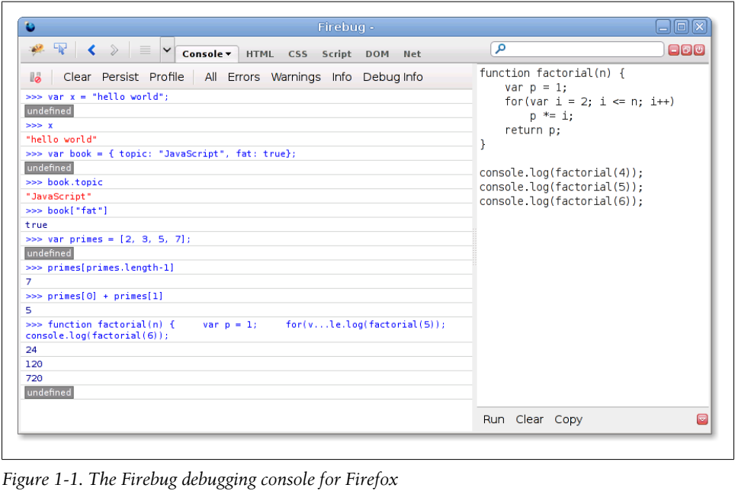
Figure 1-1

Slide 14
Core JavaScript
This section is a tour of the JavaScript language, and also a tour of Part I of this book.
After this introductory chapter, we dive into JavaScript at the lowest level: Chapter 2, Lexical Structure, explains things like JavaScript comments, semicolons, and the Unicode character set.
Chapter 3, Types, Values, and Variables, starts to get more interesting: it explains JavaScript variables and the values you can assign to those variables.
Here’s some sample code to illustrate the highlights of those two chapters: Code 1-1.
Two other very important types that JavaScript programs can manipulate are objects and arrays.
These are the subject of Chapter 6, Objects, and Chapter 7, Arrays, but they are so important that you’ll see them many times before you reach those chapters: Code 1-2.
The syntax illustrated above for listing array elements within square braces or mapping object property names to property values inside curly braces is known as an initializer expression, and it is just one of the topics of Chapter 4, Expressions and Operators: Code 1-3.
An expression is a phrase of JavaScript that can be evaluated to produce a value.
Ex: The use of . and [ ] to refer to the value of an object property or array element is an expression.
You may have noticed in the code above that when an expression stands alone on a line, the comment that follows it begins with an arrow (=>) and the value of the expression.

Slide 15
Core JavaScript |
This is a convention that you’ll see throughout this book. One of the most common ways to form expressions in JavaScript is to use operators like these:
If the phrases of JavaScript are expressions, then the full sentences are statements, which are the topic of Chapter 5, Statements: Code 1-4.
In the code above, the lines that end with semicolons are statements. (In the code below, you’ll see multiline statements that do not end with semicolons.)
There is actually a lot of overlap between statements and expressions.
Roughly, an expression is something that computes a value but doesn’t do anything: it doesn’t alter the program state in any way.
Statements, on the other hand, don’t have a value (or don’t have a value that we care about), but they do alter the state.
You’ve seen variable declarations and assignment statements above.
The other broad category of statement is control structures, such as conditionals and loops.
Examples are below, after we cover functions.
A function is a named and parametrized block of JavaScript code that you define once, and can then invoke over and over again.

Slide 16
Core JavaScript ||
Functions aren’t covered formally until Chapter 8, Functions, but like objects and arrays, you’ll see them many times before you get to that chapter.
Here are some simple examples: Code 1-4.
When we combine functions with objects, we get methods: Code 1-5.
Now, as promised, here are some functions whose bodies demonstrate common JavaScript control structure statements: Code 1-6.
JavaScript is an object-oriented language, but it is quite different than most.
Chapter 9, Classes and Modules, covers object-oriented programming in JavaScript in detail, with lots of examples, and is one of the longest chapters in the book.
Here is a very simple example that demonstrates how to define a JavaScript class to represent 2D geometric points: Code 1-7.
Objects that are instances of this class have a single method named r( ) that computes the distance of the point from the origin.
Chapter 9 is really the climax of Part I, and the chapters that follow wrap up some loose ends and bring our exploration of the core language to a close.

Slide 17
Core JavaScript |||
Chapter 10, Pattern Matching with Regular Expressions, explains the regular expression grammar and demonstrates how to use these “regexps” for textual pattern matching.
Chapter 11, JavaScript Subsets and Extensions, covers subsets and extensions of core JavaScript.
Finally, before we plunge into client-side JavaScript in web browsers, Chapter 12, Server-Side JavaScript, introduces two ways to use JavaScript outside of web browsers.

Slide 18
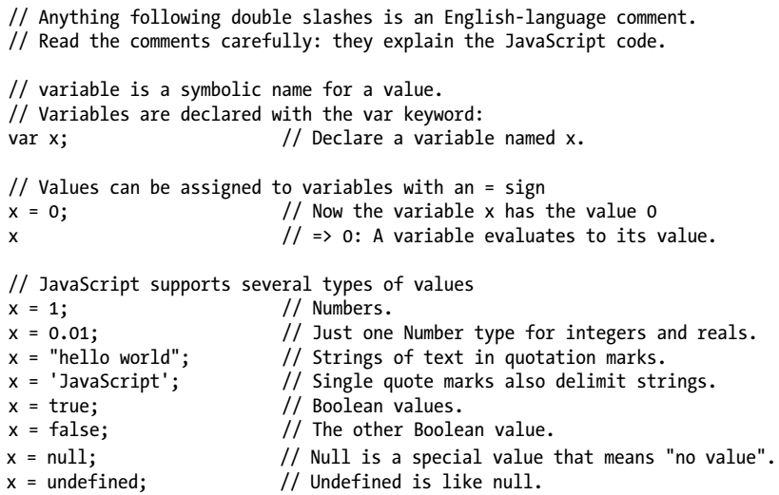
Code 1-1

Slide 19
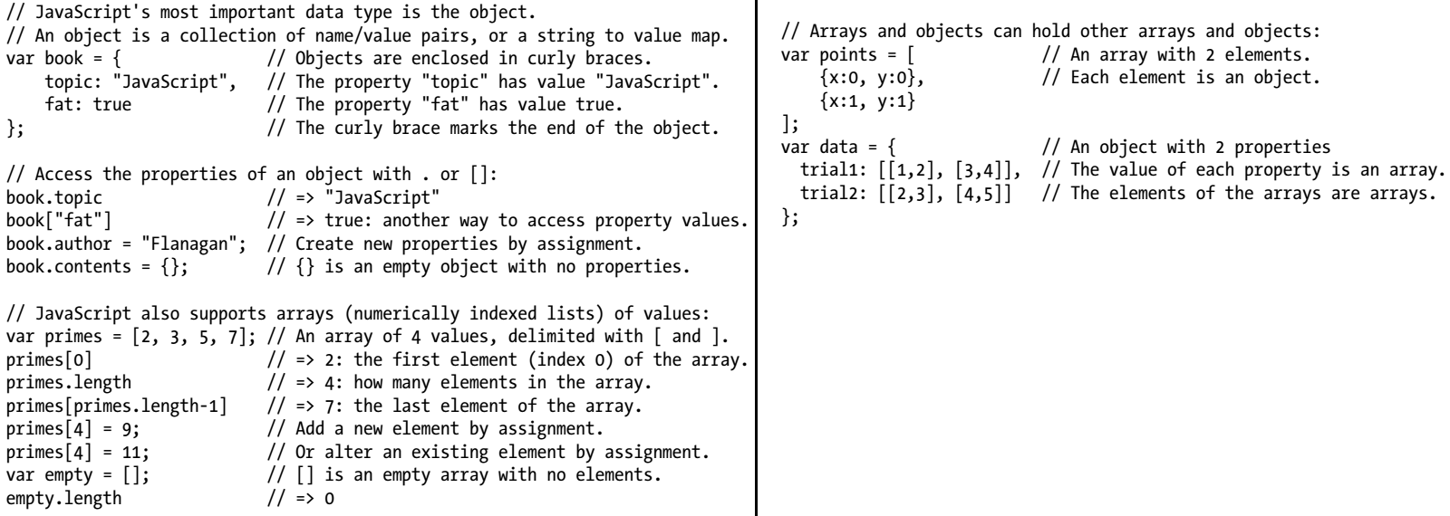
Code 1-2

Slide 20
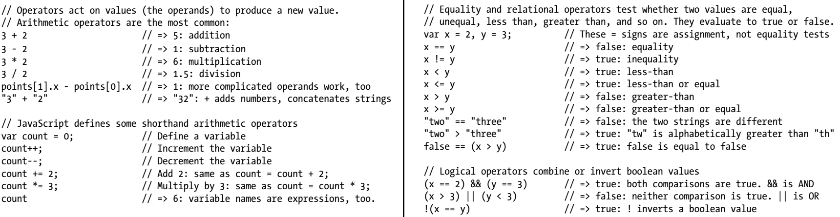
Code 1-3

Slide 21
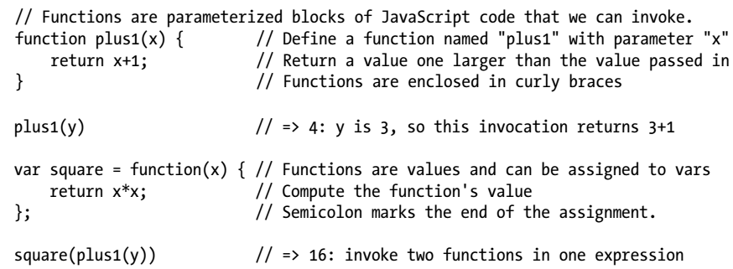
Code 1-4

Slide 22
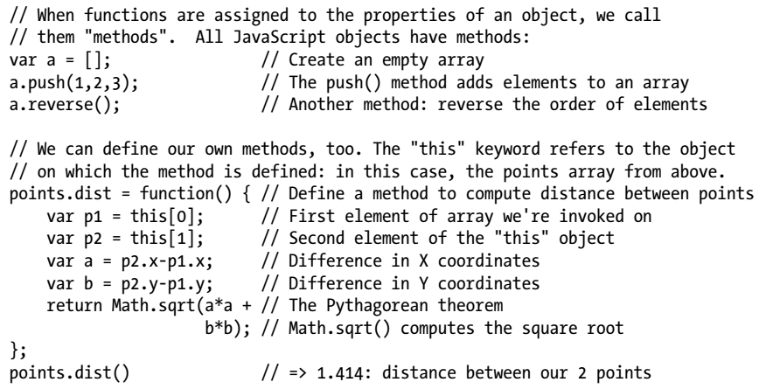
Code 1-5

Slide 23
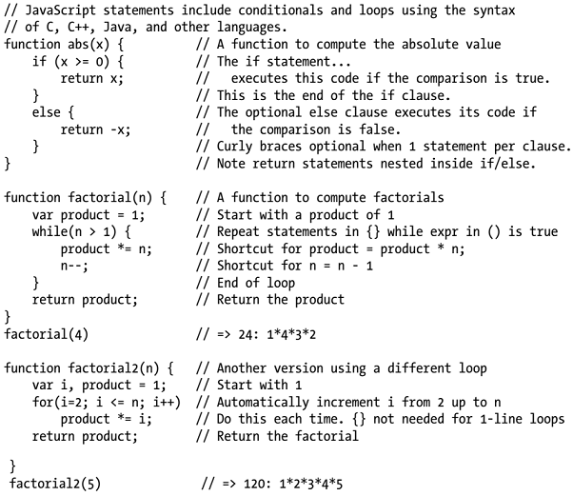
Code 1-6

Slide 24
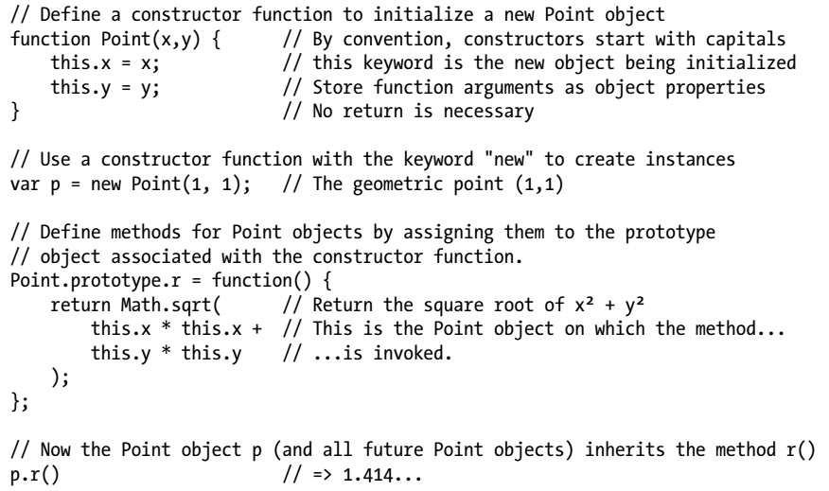
Code 1-7

Slide 25
Client-Side JavaScript
Client-side JavaScript does not exhibit the nonlinear cross-reference problem nearly to the extent that the core language does, and it is possible to learn how to use JavaScript in web browsers in a fairly linear sequence.
But you’re probably reading this book to learn client-side JavaScript, and Part II is a long way off, so this section is a quick sketch of basic client-side programming techniques, followed by an in-depth example.
Chapter 13, JavaScript in Web Browsers, is the first chapter of Part II and it explains in detail how to put JavaScript to work in web browsers.
The most important thing you’ll learn in that chapter is that JavaScript code can be embedded within HTML files using the <script> tag: Code 1-8.
Chapter 14, The Window Object, explains techniques for scripting the web browser and covers some important global functions of client-side JavaScript. For example: Code 1-9.
Chapter 15, Scripting Documents, gets down to the real business of client-side JavaScript, scripting HTML document content.
It shows you how to select particular HTML elements from within a document, how to set HTML attributes of those elements, how to alter the content of those elements, and how to add new elements to the document.
This function demonstrates a number of these basic document searching and modification techniques: Code 1-10.

Slide 26
Client-Side JavaScript |
Chapter 15 shows how JavaScript can script the HTML elements that define web content.
Chapter 16, Scripting CSS, shows how you can use JavaScript with the CSS styles that define the presentation of that content.
This is often done with the style or class attribute of HTML elements: Code 1-11.
JavaScript allows us to script the HTML content and CSS presentation of documents in web browsers, but it also allows us to define behavior for those documents with event handlers.
An event handler is a JavaScript function that we register with the browser and the browser invokes when some specified type of event occurs.
The event of interest might be a mouse click or a key press (or on a smart phone, it might be a two-finger gesture of some sort).
Or an event handler might be triggered when the browser finishes loading a document, when the user resizes the browser window, or when the user enters data into an HTML form element.
Chapter 17, Handling Events, explains how you can define and register event handlers and how the browser invokes them when events occur.
The simplest way to define event handlers is with HTML attributes that begin with “on”. The “onclick” handler is a particularly useful one when you’re writing simple test programs.

Slide 27
Client-Side JavaScript ||
Suppose that you had typed in the debug( ) and hide( ) functions from above and saved them in files named debug.js and hide.js.
You could write a simple HTML test file using <button> elements with onclick event handler attributes: Code 1-12.
Here is some more client-side JavaScript code that uses events.
It registers an event handler for the very important “load” event, and it also demonstrates a more sophisticated way of registering event handler functions for “click” events: Code 1-13.
Chapters 15, 16, and 17 explain how you can use JavaScript to script the content (HTML), presentation (CSS), and behavior (event handling) of web pages.
The APIs described in those chapters are somewhat complex and, until recently, riddled with browser incompatibilities.
For these reasons, many or most client-side JavaScript programmers choose to use a client-side library or framework to simplify their basic programming tasks.
The most popular such library is jQuery, the subject of Chapter 19, The jQuery Library.
jQuery defines a clever and easy-to-use API for scripting document content, presentation, and behavior.
It has been thoroughly tested and works in all major browsers, including old ones like IE6.

Slide 28
Client-Side JavaScript |||
jQuery code is easy to identify because it makes frequent use of a function named $( ).
Here is what the debug( ) function used previously looks like when rewritten to use jQuery: Code 1-14.
The four chapters of Part II described so far have all really been about web pages.
Four more chapters shift gears to focus on web applications.
These chapters are not about using web browsers to display documents with scriptable content, presentation, and behavior.
Instead, they’re about using web browsers as application platforms, and they describe the APIs that modern browsers provide to support sophisticated client-side web apps.
Chapter 18, Scripted HTTP, explains how to make scripted HTTP requests with JavaScript—a kind of networking API.
Chapter 20, Client-Side Storage, describes mechanisms for storing data—and even entire applications—on the client side for use in future browsing sessions.
Chapter 21, Scripted Media and Graphics, covers a clientside API for drawing arbitrary graphics in an HTML <canvas> tag.
And, finally, Chapter 22, HTML5 APIs, covers an assortment of new web app APIs specified by or affiliated with HTML5.

Slide 29
Client-Side JavaScript ||||
Networking, storage, graphics: these are OS-type services being provided by the web browser, defining a new cross-platform application environment.
If you are targeting browsers that support these new APIs, it is an exciting time to be a client-side JavaScript programmer.
There are no code samples from these final four chapters here, but the extended example below uses some of these new APIs.

Slide 30
NOTE
Note that the client-side example code shown in this section comes in longer snippets than the core language examples earlier in the chapter.
These examples are not designed to be typed into a Firebug (or similar) console window.
Instead you can embed them in an HTML file and try them out by loading them in your web browser.
The code above, for instance, works as a stand-alone HTML file.

Slide 31
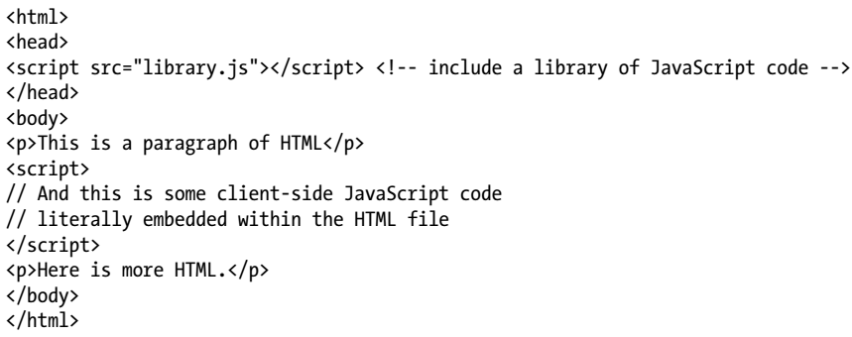
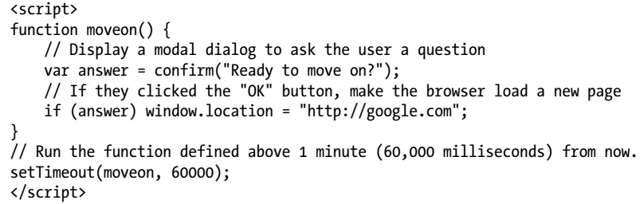
Code 1-8 || 1-9

Slide 32
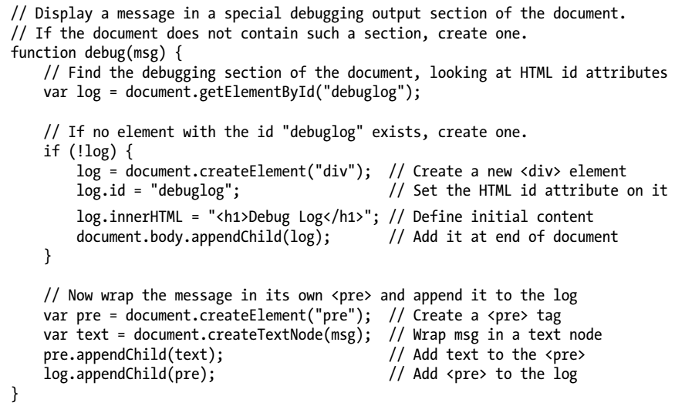
Code 1-10

Slide 33
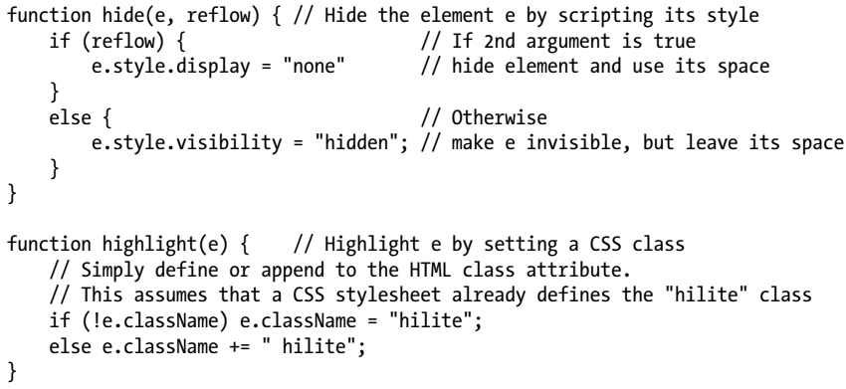
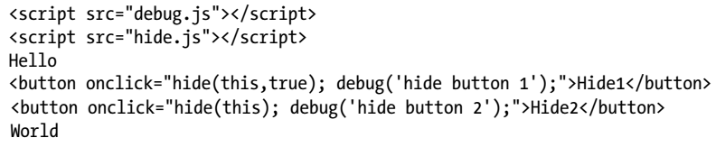
Code 1-11 || 1-12

Slide 34
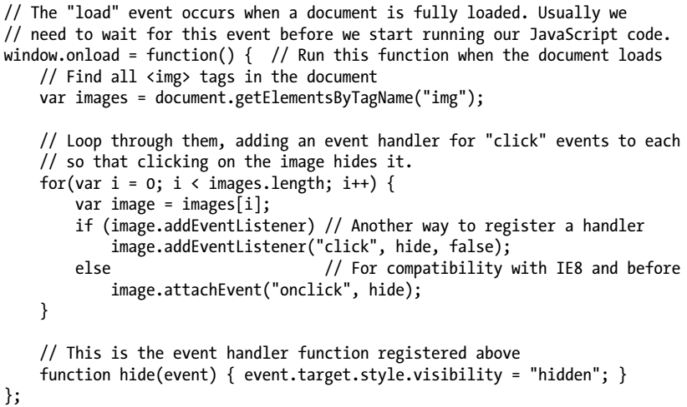
Code 1-13

Slide 35
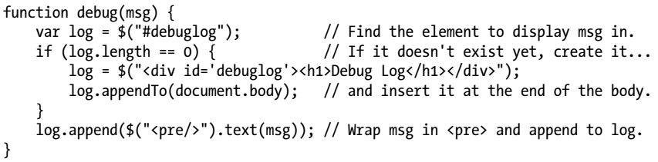
Code 1-14

Slide 36
Example: A JavaScript Loan Calculator
This chapter ends with an extended example that puts many of these techniques together and shows what real-world client-side JavaScript (plus HTML and CSS) programs look like.
Example 1-1 lists the code for the simple loan payment calculator application pictured in Figure 1-2.
It is worth reading through Example 1-1 carefully.
You shouldn’t expect to understand everything, but the code is heavily commented and you should be able to at least get the big-picture view of how it works.
The example demonstrates a number of core JavaScript language features, and also demonstrates important client-side JavaScript techniques:
How to find elements in a document.
How to get user input from form input elements.
How to set the HTML content of document elements.
How to store data in the browser.
How to make scripted HTTP requests.
How to draw graphics with the <canvas> element.

Slide 37
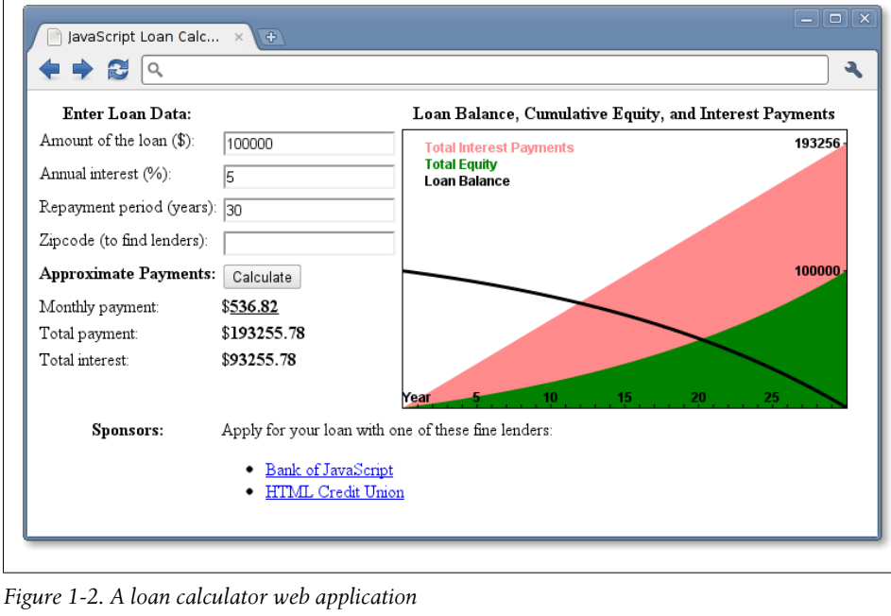
Figure 1-2

Slide 38
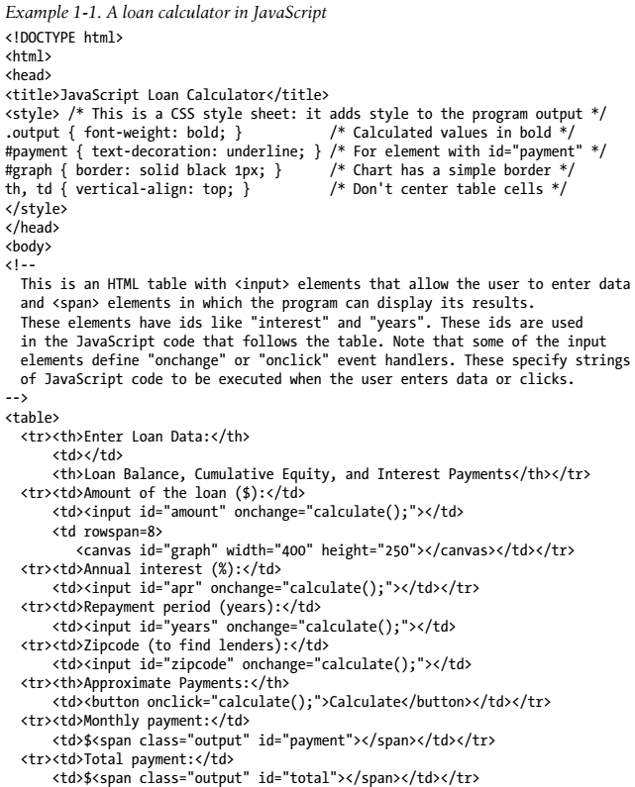
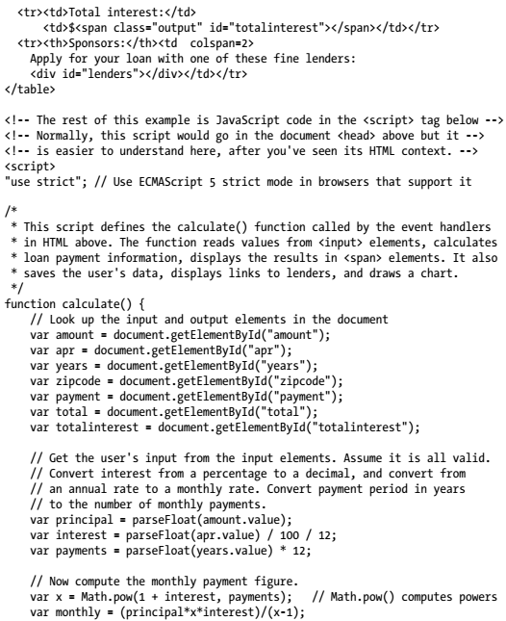
Example 1-1

Slide 39
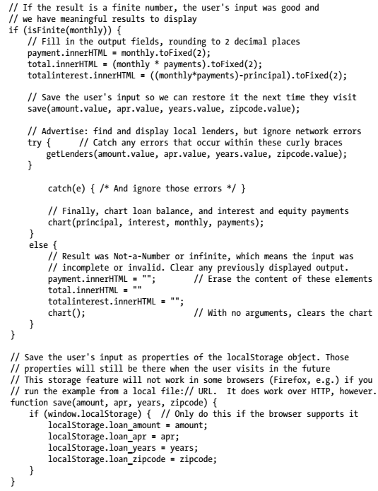
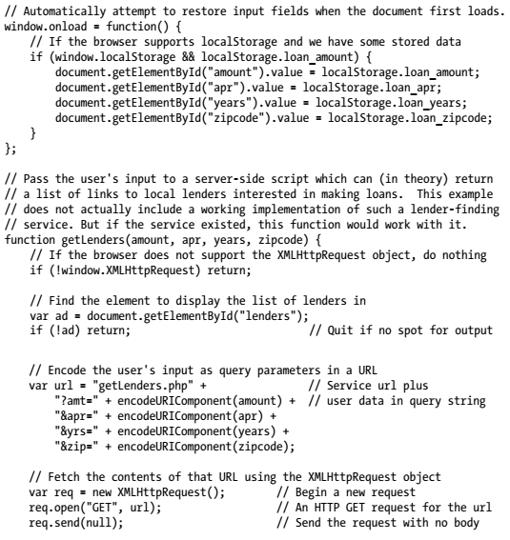
Example 1-1 |

Slide 40
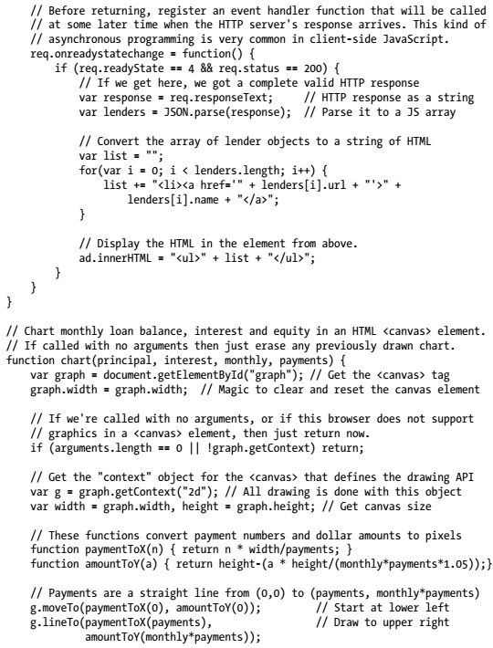
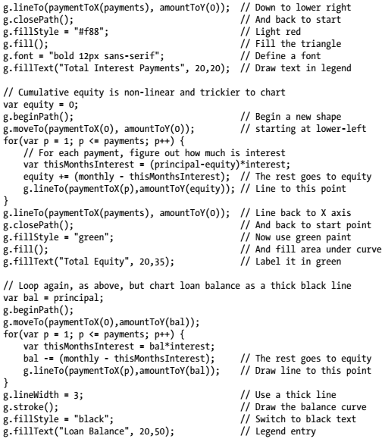
Example 1-1 ||

Slide 41
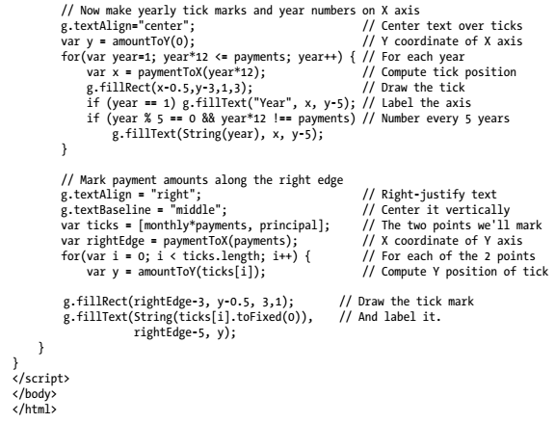
Example 1-1 |||

Slide 42
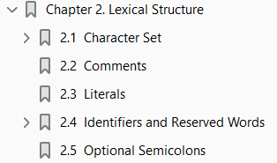
2
Lexical Structure

Slide 43
Intro
The lexical structure of a programming language is the set of elementary rules that specifies how you write programs in that language.
It is the lowest-level syntax of a language; it specifies such things as
what variable names look like
the delimiter characters for comments
how one program statement is separated from the next
This short chapter documents the lexical structure of JavaScript.

Slide 44
Character Set
JavaScript programs are written using the Unicode character set.
Unicode is a superset of ASCII and Latin-1 and supports virtually every written language currently used on the planet.
ECMAScript 3 requires JavaScript implementations to support Unicode version 2.1 or later, and ECMAScript 5 requires implementations to support Unicode 3 or later.
See the sidebar in §3.2 for more about Unicode and JavaScript.

Slide 45
Case Sensitivity
JavaScript is a case-sensitive language.
This means that language keywords, variables, function names, and other identifiers must always be typed with a consistent capitalization of letters.
The while keyword, for example, must be typed “while,” not “While” or “WHILE.”
Similarly, online, Online, OnLine, and ONLINE are four distinct variable names.
Note, however, that HTML is not case-sensitive (although XHTML is).
Because of its close association with client-side JavaScript, this difference can be confusing.
Many client-side JavaScript objects and properties have the same names as the HTML tags and attributes they represent.
While these tags and attribute names can be typed in any case in HTML, in JavaScript they typically must be all lowercase.
For example, the HTML onclick event handler attribute is sometimes specified as onClick in HTML, but it must be specified as onclick in JavaScript code (or in XHTML documents).

Slide 46
Whitespace, Line Breaks, Format Control Char
JavaScript ignores spaces that appear between tokens in programs.
For the most part, JavaScript also ignores line breaks (but see §2.5 for an exception).
Because you can use spaces and newlines freely in your programs, you can format and indent your programs in a neat and consistent way that makes the code easy to read and understand.
In addition to the regular space character (\u0020), JavaScript also recognizes the following characters as whitespace:
tab (\u0009)
vertical tab (\u000B)
form feed (\u000C)
nonbreaking space (\u00A0)
byte order mark (\uFEFF)
any character in Unicode category Zs
JavaScript recognizes the following characters as line terminators:
line feed (\u000A)
carriage return (\u000D)

Slide 47
Whitespace, Line Breaks, Format Control Char |
line separator (\u2028)
paragraph separator (\u2029)
A carriage return, line feed sequence is treated as a single line terminator.
Unicode format control characters (category Cf), such as RIGHT-TO-LEFT MARK (\u200F) and LEFT-TO-RIGHT MARK (\u200E), control the visual presentation of the text they occur in.
They are important for the proper display of some non-English languages and are allowed in JavaScript
Comments
string literals
regular expression literals,
but not in the identifiers (e.g., variable names) of a JavaScript program
As a special case, ZERO WIDTH JOINER (\u200D) and ZERO WIDTH NON-JOINER (\u200C) are allowed in identifiers, but not as the first character.
As noted above, the byte order mark format control character (\uFEFF) is treated as a space character.

Slide 48
Unicode Escape Sequences
Some computer hardware and software can not display or input the full set of Unicode characters.
To support programmers using this older technology, JavaScript defines special sequences of six ASCII characters to represent any 16-bit Unicode codepoint.
These Unicode escapes begin with the characters \u and are followed by exactly four hexadecimal digits (using uppercase or lowercase letters A–F).
Unicode escapes may appear in JavaScript string literals, regular expression literals, and in identifiers (but not in language keywords).
The Unicode escape for the character é, for example, is \u00E9, and the following two JavaScript strings are identical: "café"
Unicode escapes may also appear in comments, but since comments are ignored, they are treated as ASCII characters in that context and not interpreted as Unicode.

Slide 49
Normalization
Unicode allows more than one way of encoding the same character.
The string “é”, for example, can be encoded as the single Unicode character \u00E9 or as a regular ASCII e followed by the acute accent combining mark \u0301.
These two encodings may look exactly the same when displayed by a text editor, but they have different binary encodings and are considered different by the computer.
The Unicode standard defines the preferred encoding for all characters and specifies a normalization procedure to convert text to a canonical form suitable for comparisons.
JavaScript assumes that the source code it is interpreting has already been normalized and makes no attempt to normalize identifiers, strings, or regular expressions itself.

Slide 50
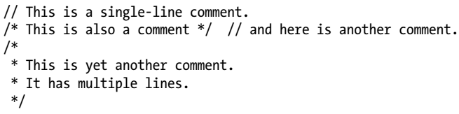
Comments
JavaScript supports two styles of comments.
Any text between a // and the end of a line is treated as a comment and is ignored by JavaScript.
Any text between the characters /* and */ is also treated as a comment; these comments may span multiple lines but may not be nested.
The following lines of code are all legal JavaScript comments:

Slide 51
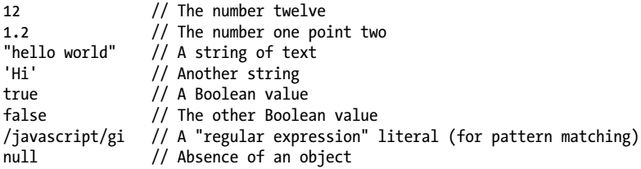
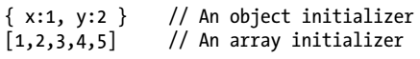
Literals
A literal is a data value that appears directly in a program.
The following are all literals:
Complete details on numeric and string literals appear in Chapter 3.
Regular expression literals are covered in Chapter 10.
More complex expressions (see §4.2) can serve as array and object literals.
For example:

Slide 52
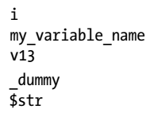
Identifiers and Reserved Words
An identifier is simply a name.
In JavaScript, identifiers are used to name variables and functions and to provide labels for certain loops in JavaScript code.
A JavaScript identifier must begin with
a letter
an underscore (_) or
a dollar sign ($).
Subsequent characters can be letters, digits, underscores, or dollar signs. (Digits are not allowed as the first character so that JavaScript can easily distinguish identifiers from numbers.)
These are all legal identifiers:
For portability and ease of editing, it is common to use only ASCII letters and digits in identifiers.

Slide 53
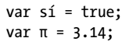
Identifiers and Reserved Words |
Note, however, that JavaScript allows identifiers to contain letters and digits from the entire Unicode character set.(Technically, the ECMAScript standard also allows Unicode characters from the obscure categories Mn, Mc, and Pc to appear in identifiers after the first character.)
This allows programmers to use variable names from non-English languages and also to use mathematical symbols:
Like any language, JavaScript reserves certain identifiers for use by the language itself.
These “reserved words” cannot be used as regular identifiers. They are listed below.

Slide 54
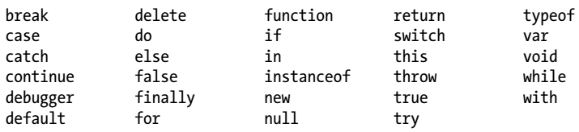
Reserved Words
JavaScript reserves a number of identifiers as the keywords of the language itself.
You cannot use these words as identifiers in your programs:
JavaScript also reserves certain keywords that are not currently used by the language but which might be used in future versions.
ECMAScript 5 reserves the following words:
In addition, the following words, which are legal in ordinary JavaScript code, are reserved in strict mode:

Slide 55
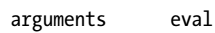
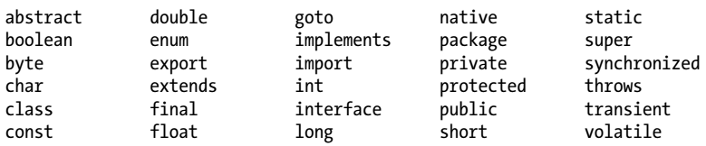
Reserved Words |
Strict mode also imposes restrictions on the use of the following identifiers.
They are not fully reserved, but they are not allowed as variable, function, or parameter names:
ECMAScript 3 reserved all the keywords of the Java language, and although this has been relaxed in ECMAScript 5, you should still avoid all of these identifiers if you plan to run your code under an ECMAScript 3 implementation of JavaScript:
JavaScript predefines a number of global variables and functions, and you should avoid using their names for your own variables and functions:

Slide 56
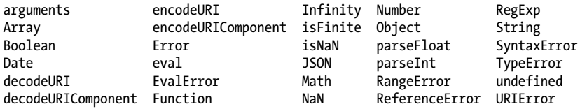
Reserved Words ||
Keep in mind that JavaScript implementations may define other global variables and functions, and each specific JavaScript embedding (client-side, server-side, etc.) will have its own list of global properties.
See the Window object in Part IV for a list of the global variables and functions defined by client-side JavaScript.

Slide 57
Optional Semicolons
Like many programming languages, JavaScript uses the semicolon (;) to separate statements (see Chapter 5) from each other.
This is important to make the meaning of your code clear: without a separator, the end of one statement might appear to be the beginning of the next, or vice versa.
In JavaScript, you can usually omit the semicolon between two statements if those statements are written on separate lines. (You can also omit a semicolon at the end of a program or if the next token in the program is a closing curly brace }.)
Many JavaScript programmers (and the code in this book) use semicolons to explicitly mark the ends of statements, even where they are not required.
Another style is to omit semicolons whenever possible, using them only in the few situations that require them.
Whichever style you choose, there are a few details you should understand about optional semicolons in JavaScript.

Slide 58
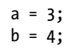
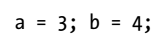
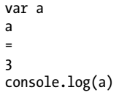
Scenarios
Consider the following code.
Since the two statements appear on separate lines, the first semicolon could be omitted:
Written as follows, however, the first semicolon is required: a = 3; b = 4;
Note that JavaScript does not treat every line break as a semicolon: it usually treats line breaks as semicolons only if it can’t parse the code without the semicolons.
More formally (and with two exceptions described below), JavaScript treats a line break as a semicolon if the next nonspace character cannot be interpreted as a continuation of the current statement.
Consider the following code:

Slide 59
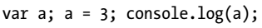
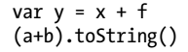
Scenarios |
JavaScript interprets this code like this:
JavaScript does treat the first line break as a semicolon because it cannot parse the code var a a without a semicolon.
The second a could stand alone as the statement a;, but JavaScript does not treat the second line break as a semicolon because it can continue parsing the longer statement a = 3;.
These statement termination rules lead to some surprising cases.
This code looks like two separate statements separated with a newline:
But the parentheses on the second line of code can be interpreted as a function invocation of f from the first line, and JavaScript interprets the code like this:

Slide 60
Guidelines
More likely than not, this is not the interpretation intended by the author of the code.
In order to work as two separate statements, an explicit semicolon is required in this case.
In general, if a statement begins with (, [, /, +, or -, there is a chance that it could be interpreted as a continuation of the statement before.
Statements beginning with /, +, and - are quite rare in practice, but statements beginning with ( and [ are not uncommon at all, at least in some styles of JavaScript programming.
Some programmers like to put a defensive semicolon at the beginning of any such statement so that it will continue to work correctly even if the statement before it is modified and a previously terminating semicolon removed:
There are two exceptions to the general rule that JavaScript interprets line breaks as semicolons when it cannot parse the second line as a continuation of the statement on the first line.
The first exception involves the return, break, and continue statements (see Chapter 5).
These statements often stand alone, but they are sometimes followed by an identifier or expression.

Slide 61
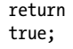
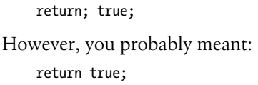
Guidelines |
If a line break appears after any of these words (before any other tokens), JavaScript will always interpret that line break as a semicolon. For example, if you write:
JavaScript assumes you meant:
What this means is that you must not insert a line break between return, break or continue and the expression that follows the keyword.
If you do insert a line break, your code is likely to fail in a nonobvious way that is difficult to debug.
The second exception involves the ++ and −− operators (§4.8).
These operators can be prefix operators that appear before an expression or postfix operators that appear after an expression.

Slide 62
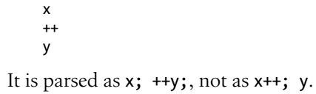
Guidelines |
If you want to use either of these operators as postfix operators, they must appear on the same line as the expression they apply to.
Otherwise, the line break will be treated as a semicolon, and the ++ or -- will be parsed as a prefix operator applied to the code that follows.
Consider this code, for example:

Slide 63
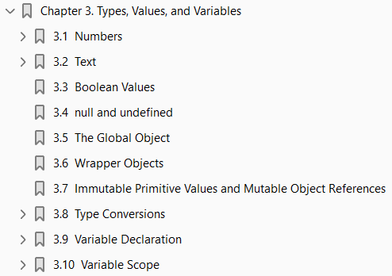
3
Types, Values, and Variables

Slide 64
Intro
Computer programs work by manipulating values, such as
the number 3.14
the text “Hello World.”
The kinds of values that can be represented and manipulated in a programming language are known as types, and one of the most fundamental characteristics of a programming language is the set of types it supports.
When a program needs to retain a value for future use, it assigns the value to (or “stores” the value in) a variable.
A variable defines a symbolic name for a value and allows the value to be referred to by name.
The way that variables work is another fundamental characteristic of any programming language.
This chapter explains
Types
Values
variables in JavaScript
These introductory paragraphs provide an overview, and you may find it helpful to refer to §1.1 while you read them.

Slide 65
Intro |
The sections that follow cover these topics in depth.
JavaScript types can be divided into two categories:
primitive types
object types

Slide 66
Primitive Types
JavaScript’s primitive types include
Numbers
strings of text (known as strings),
Boolean truth values (known as booleans)
A significant portion of this chapter is dedicated to a detailed explanation of the numeric (§3.1) and string (§3.2) types in JavaScript.
Booleans are covered in §3.3.
The special JavaScript values null and undefined are primitive values, but they are not numbers, strings, or booleans.
Each value is typically considered to be the sole member of its own special type.
§3.4 has more about null and undefined.

Slide 67
Object
Any JavaScript value that is not
a number
a string
a boolean
or null
or undefined
is an object.
An object (that is, a member of the type object) is a collection of properties where each property has a name and a value (either a primitive value, such as a number or string, or an object).
One very special object, the global object, is covered in §3.5, but more general and more detailed coverage of objects is in Chapter 6.
An ordinary JavaScript object is an unordered collection of named values.
The language also defines a special kind of object, known as an array, that represents an ordered collection of numbered values.
The JavaScript language includes special syntax for working with arrays, and arrays have some special behavior that distinguishes them from ordinary objects. Arrays are the subject of Chapter 7.

Slide 68
Function
JavaScript defines another special kind of object, known as a function.
A function is an object that has executable code associated with it.
A function may be invoked to run that executable code and return a computed value.
Like arrays, functions behave differently from other kinds of objects, and JavaScript defines a special language syntax for working with them.
The most important thing about functions in JavaScript is that they are true values and that JavaScript programs can treat them like regular objects.
Functions are covered in Chapter 8.
Functions that are written to be used (with the new operator) to initialize a newly created object are known as constructors.
Each constructor defines a class of objects—the set of objects initialized by that constructor.

Slide 69
Classes
Classes can be thought of as subtypes of the object type.
In addition to the Array and Function classes, core JavaScript defines three other useful classes.
The Date class defines objects that represent dates.
The RegExp class defines objects that represent regular expressions (a powerful pattern-matching tool described in Chapter 10).
And the Error class defines objects that represent syntax and runtime errors that can occur in a JavaScript program.
You can define your own classes of objects by defining appropriate constructor functions. This is explained in Chapter 9.

Slide 70
Garbage Collection
The JavaScript interpreter performs automatic garbage collection for memory management.
This means that a program can create objects as needed, and the programmer never needs to worry about destruction or deallocation of those objects.
When
an object is no longer reachable
when a program no longer has any way to refer to it
the interpreter knows it can never be used again and automatically reclaims the memory it was occupying.

Slide 71
Method Invocation
JavaScript is an object-oriented language.
Loosely, this means that rather than having globally defined functions to operate on values of various types, the types themselves define methods for working with values.
To sort the elements of an array a, for example
we don’t pass a to a sort( ) function.
Instead, we invoke the sort( ) method of a:
Method definition is covered in Chapter 9.
Technically, it is only JavaScript objects that have methods.
But numbers, strings, and boolean values behave as if they had methods (§3.6 explains how this works).
In JavaScript, null and undefined are the only values that methods cannot be invoked on.

Slide 72
Mutable & Immutable Types
JavaScript’s types can be divided into
primitive types
object types
And they can be divided into types
with methods
without methods
They can also be categorized as
Mutable
Immutable
A value of a mutable type can change.
Objects and arrays are mutable: a JavaScript program can change the values of object properties and array elements.
Numbers, booleans, null, and undefined are immutable—it doesn’t even make sense to talk about changing the value of a number, for example.

Slide 73
Mutable & Immutable Types |
Strings can be thought of as arrays of characters, and you might expect them to be mutable.
In JavaScript, however, strings are immutable: you can access the text at any index of a string, but JavaScript provides no way to alter the text of an existing string.
The differences between mutable and immutable values are explored further in §3.7.

Slide 74
Not Strongly-typed
JavaScript converts values liberally from one type to another.
If a program expects a string, for example, and you give it a number, it will automatically convert the number to a string for you.
If you use a nonboolean value where a boolean is expected, JavaScript will convert accordingly.
The rules for value conversion are explained in §3.8.
JavaScript’s liberal value conversion rules affect its definition of equality, and the == equality operator performs type conversions as described in §3.8.1.
JavaScript variables are untyped: you can assign a value of any type to a variable, and you can later assign a value of a different type to the same variable.
Variables are declared with the var keyword.
JavaScript uses lexical scoping.
Variables declared outside of a function are global variables and are visible everywhere in a JavaScript program.
Variables declared inside a function have function scope and are visible only to code that appears inside that function.
Variable declaration and scope are covered in §3.9 and §3.10.

Slide 75
Numbers
Unlike many languages, JavaScript does not make a distinction between
integer values
floating-point values
All numbers in JavaScript are represented as floating-point values.
JavaScript represents numbers using the 64-bit floating-point format defined by the IEEE 754 standard, which means it can represent numbers
as large as ±1.7976931348623157 × 10³⁰⁸
as small as ±5 × 10⁻³²⁴
The JavaScript number format allows you to exactly represent all integers between −9007199254740992 (−2⁵³) and 9007199254740992 (2⁵³), inclusive.
If you use integer values larger than this, you may lose precision in the trailing digits.
Note, however, that certain operations in JavaScript (such as array indexing and the bitwise operators described in Chapter 4) are performed with 32-bit integers.
When a number appears directly in a JavaScript program, it’s called a numeric literal.
JavaScript supports numeric literals in several formats, as described in the following sections.

Slide 76
Numbers |
Note that any numeric literal can be preceded by a minus sign (-) to make the number negative.
Technically, however, - is the unary negation operator (see Chapter 4) and is not part of the numeric literal syntax.

Slide 77
NOTE
64-bit floating-point format defined by the IEEE 754 standard
This format should be familiar to Java programmers as the format of the double type.
It is also the double format used in almost all modern implementations of C and C++.

Slide 78
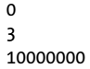
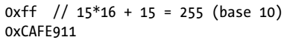
Integer Literals
In a JavaScript program, a base-10 integer is written as a sequence of digits. For example:
In addition to base-10 integer literals, JavaScript recognizes hexadecimal (base-16) values.
A hexadecimal literal begins with “0x” or “0X”, followed by a string of hexadecimal digits.
A hexadecimal digit is one of the digits 0 through 9 or the letters a (or A) through f (or F), which represent values 10 through 15.
Here are examples of hexadecimal integer literals:
Although the ECMAScript standard does not support them, some implementations of JavaScript allow you to specify integer literals in octal (base-8) format.
An octal literal begins with the digit 0 and is followed by a sequence of digits, each between 0 and 7. For example:

Slide 79
Integer Literals |
Since some implementations support octal literals and some do not, you should never write an integer literal with a leading zero;
you cannot know in this case whether an implementation will interpret it as an octal or decimal value.
In the strict mode of ES 5 (§5.7.3), octal literals are explicitly forbidden.

Slide 80
Floating-Point Literals
Floating-point literals can have a decimal point; they use the traditional syntax for real numbers.
A real value is represented as
the integral part of the number
followed by a decimal point
the fractional part of the number.
Floating-point literals may also be represented using exponential notation:
a real number
followed by the letter e (or E)
followed by an optional plus or minus sign
followed by an integer exponent.
This notation represents the real number multiplied by 10 to the power of the exponent.
More succinctly, the syntax is: Code 3-0.

Slide 81
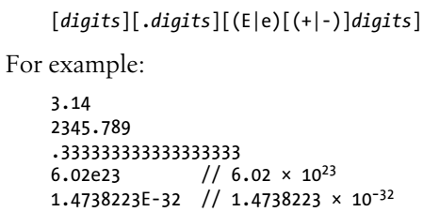
Code 3-0

Slide 82
Arithmetic in JavaScript
JavaScript programs work with numbers using the arithmetic operators that the language provides.
These include
+ for addition
- for subtraction
* for multiplication,
/ for division
% for modulo (remainder after division)
Full details on these and other operators can be found in Chapter 4.
In addition to these basic arithmetic operators, JavaScript supports more complex mathematical operations through a set of functions and constants defined as properties of the Math object: Code 3-1.
See the Math object in the reference section for complete details on all the mathematical functions supported by JavaScript.

Slide 83
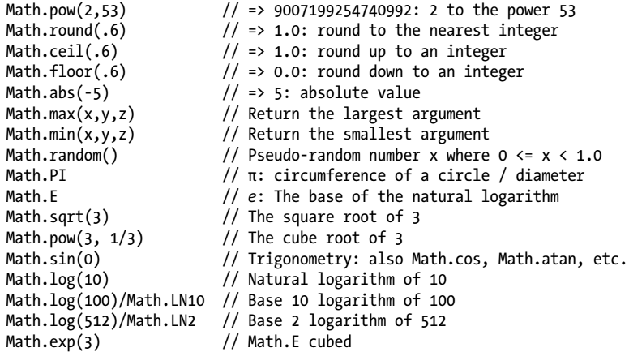
Code 3-1

Slide 84
Result of Numeric Operations
Arithmetic in JavaScript does not raise errors in cases of
Overflow
Underflow
division by zero
When the result of a numeric operation is larger than the largest representable number (overflow), the result is a special infinity value, which JavaScript prints as Infinity.
Similarly, when a negative value becomes larger than the largest representable negative number, the result is negative infinity, printed as -Infinity.
The infinite values behave as you would expect:
Adding
Subtracting
Multiplying
Dividing
them by anything results in an infinite value (possibly with the sign reversed).

Slide 85
Result of Numeric Operations |
Underflow occurs when the result of a numeric operation is closer to zero than the smallest representable number.
In this case, JavaScript returns 0.
If underflow occurs from a negative number, JavaScript returns a special value known as “negative zero.”
This value is almost completely indistinguishable from regular zero and JavaScript programmers rarely need to detect it.
Division by zero is not an error in JavaScript: it simply returns
Infinity
negative infinity
There is one exception, however: zero divided by zero does not have a well-defined value, and the result of this operation is the special not-a-number value, printed as NaN.
NaN also arises if you attempt to
divide infinity by infinity
take the square root of a negative number
use arithmetic operators with non-numeric operands that cannot be converted to numbers.

Slide 86
Global variables: Infinity, NaN
JavaScript predefines global variables
Infinity
NaN
to hold the
positive infinity
not-a-number value
In ECMAScript 3, these are read/write values and can be changed.
ECMAScript 5 corrects this and makes the values read-only.
The Number object defines alternatives that are read-only even in ECMAScript 3.
Here are some examples: Code 3-2.
The not-a-number value has one unusual feature in JavaScript:
it does not compare equal to any other value, including itself.
This means that you can’t write x == NaN to determine whether the value of a variable x is NaN.
Instead, you should write x != x.
That expression will be true if, and only if, x is NaN.

Slide 87
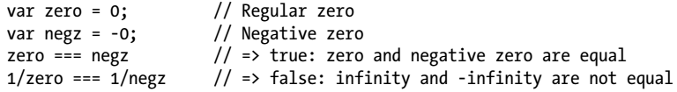
Global variables: Infinity, NaN |
The function isNaN( ) is similar.
It returns true if its argument is NaN, or if that argument is a non-numeric value such as a
string or
an object
The related function isFinite( ) returns true if its argument is a number other than
NaN
Infinity
-Infinity
The negative zero value is also somewhat unusual.
It compares equal (even using JavaScript’s strict equality test) to positive zero, which means that the two values are almost indistinguishable, except when used as a divisor:

Slide 88
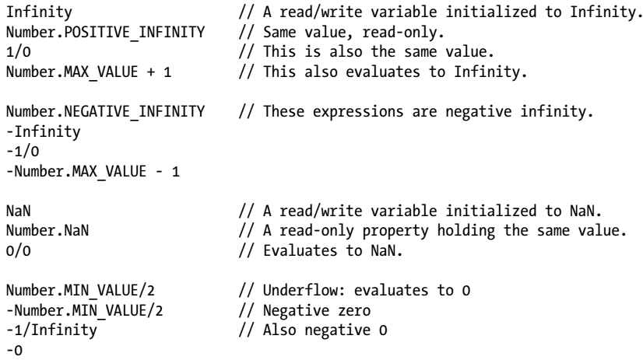
Code 3-2

Slide 89

Binary Floating-Point and Rounding Errors
There are infinitely many real numbers, but only a finite number of them (18437736874454810627, to be exact) can be represented exactly by the JavaScript floating-point format.
This means that when you’re working with real numbers in JavaScript, the representation of the number will often be an approximation of the actual number.
The IEEE-754 floating-point representation used by JavaScript (and just about every other modern programming language) is a binary representation, which can exactly represent fractions like 1/2, 1/8, and 1/1024.
Unfortunately, the fractions we use most commonly (especially when performing financial calculations) are decimal fractions 1/10, 1/100, and so on.
Binary floating-point representations cannot exactly represent numbers as simple as 0.1.
JavaScript numbers have plenty of precision and can approximate 0.1 very closely.
But the fact that this number cannot be represented exactly can lead to problems.
Consider this code:

Slide 90
Binary Floating-Point and Rounding Errors |
Because of rounding error, the difference between the approximations of .3 and .2 is not exactly the same as the difference between the approximations of .2 and .1.
It is important to understand that this problem is not specific to JavaScript:
it affects any programming language that uses binary floating-point numbers.
Also, note that the values x and y in the code above are very close to each other and to the correct value.
The computed values are adequate for almost any purpose:
the problem arises when we attempt to compare values for equality.
A future version of JavaScript may support a decimal numeric type that avoids these rounding issues.
Until then you might want to perform critical financial calculations using scaled integers.
For example, you might manipulate monetary values as integer cents rather than fractional dollars.

Slide 91

Dates and Times
Core JavaScript includes a Date( ) constructor for creating objects that represent dates and times.
These Date objects have methods that provide an API for simple date computations.
Date objects are not a fundamental type like numbers are.
This section presents a quick tutorial on working with dates.
Full details can be found in the reference section:

Slide 92
Text
A string is an immutable ordered sequence of 16-bit values, each of which typically represents a Unicode character—strings are JavaScript’s type for representing text.
The length of a string is the number of 16-bit values it contains.
JavaScript’s strings (and its arrays) use zero-based indexing:
the first 16-bit value is at position 0
the second at position 1 and so on.
The empty string is the string of length 0.
JavaScript does not have a special type that represents a single element of a string.
To represent a single 16-bit value, simply use a string that has a length of 1.

Slide 93

NOTE
Characters, Codepoints, and JavaScript Strings
JavaScript uses the UTF-16 encoding of the Unicode character set, and JavaScript strings are sequences of unsigned 16-bit values.
The most commonly used Unicode characters (those from the “basic multilingual plane”) have codepoints that fit in 16 bits and can be represented by a single element of a string.
Unicode characters whose codepoints do not fit in 16 bits are encoded following the rules of UTF-16 as a sequence (known as a “surrogate pair”) of two 16-bit values.
This means that a JavaScript string of length 2 (two 16-bit values) might represent only a single Unicode character:
The various string-manipulation methods defined by JavaScript operate on 16-bit values, not on characters.
They do not treat surrogate pairs specially, perform no normalization of the string, and do not even ensure that a string is well-formed UTF-16.

Slide 94
String Literals
To include a string literally in a JavaScript program, simply enclose the characters of the string within a matched pair of
Single
double quotes (' or ").
Double-quote characters may be contained within strings delimited by single-quote characters, and single-quote characters may be contained within strings delimited by double quotes.
Here are examples of string literals:

Slide 95
Escape Sequences in String Literals
The backslash character (\) has a special purpose in JavaScript strings. Combined with the character that follows it, it represents a character that is not otherwise representable within the string. For example, \n is an escape sequence that represents a newline character. Another example, mentioned above, is the \' escape, which represents the single quote (or apostrophe) character. This escape sequence is useful when you need to include an apostrophe in a string literal that is contained within single quotes. You can see why these are called escape sequences: the backslash allows you to escape from the usual interpretation of the single-quote character. Instead of using it to mark the end of the string, you use it as an apostrophe:
(Page 37).

Slide 96
Working with Strings
One of the built-in features of JavaScript is the ability to concatenate strings. If you use the + operator with numbers, it adds them. But if you use this operator on strings, it joins them by appending the second to the first. For example:
(Page 38).

Slide 97
Pattern Matching
JavaScript defines a RegExp() constructor for creating objects that represent textual patterns. These patterns are described with regular expressions, and JavaScript adopts Perl’s syntax for regular expressions. Both strings and RegExp objects have methods for performing pattern matching and search-and-replace operations using regular expressions. RegExps are not one of the fundamental types of JavaScript. Like Dates, they are simply a specialized kind of object, with a useful API. The regular expression grammar is complex and the API is nontrivial. They are documented in detail in Chapter 10. Because RegExps are powerful and commonly used for text processing, however, this section provides a brief overview. Although RegExps are not one of the fundamental data types in the language, they do have a literal syntax and can be encoded directly into JavaScript programs. Text between a pair of slashes constitutes a regular expression literal. The second slash in the pair can also be followed by one or more letters, which modify the meaning of the pattern. For example:
(Page 39).

Slide 98
Boolean Values
A boolean value represents truth or falsehood, on or off, yes or no. There are only two possible values of this type. The reserved words true and false evaluate to these two values. Boolean values are generally the result of comparisons you make in your JavaScript programs. For example:
(Page 40).

Slide 99
null and undefined
null is a language keyword that evaluates to a special value that is usually used to indicate the absence of a value. Using the typeof operator on null returns the string “object”, indicating that null can be thought of as a special object value that indicates “no object”. In practice, however, null is typically regarded as the sole member of its own type, and it can be used to indicate “no value” for numbers and strings as well as objects. Most programming languages have an equivalent to JavaScript’s null: you may be familiar with it as null or nil. JavaScript also has a second value that indicates absence of value. The undefined value represents a deeper kind of absence. It is the value of variables that have not been initialized and the value you get when you query the value of an object property or array element that does not exist. The undefined value is also returned by functions that have no return value, and the value of function parameters for which no argument is supplied. undefined is a predefined global variable (not a language keyword like null) that is initialized to the undefined value. In ECMAScript 3, undefined is a read/write variable, and it can be set to any value. This error is corrected in ECMAScript 5 and undefined is read-only in that version of the language. If you apply the typeof operator to the undefined value, it returns “undefined”, indicating that this value is the sole member of a special type.
(Page 41).

Slide 100
The Global Object
The sections above have explained JavaScript’s primitive types and values.
Object types—objects, arrays, and functions—are covered in chapters of their own later in this book.
But there is one very important object value that we must cover now.
The global object is a regular JavaScript object that serves a very important purpose:
the properties of this object are the globally defined symbols that are available to a JavaScript program.
When the JavaScript interpreter starts (or whenever a web browser loads a new page), it creates a new global object and gives it an initial set of properties that define:
global properties like undefined, Infinity, and NaN
global functions like isNaN( ), parseInt( ) (§3.8.2), and eval( ) (§4.12)
constructor functions like Date( ), RegExp( ), String( ), Object( ), and Array( ) (§3.8.2)
global objects like Math and JSON (§6.9)

Slide 101
Initial Properties of Global object
The initial properties of the global object are not reserved words, but they deserve to be treated as if they are.
§2.4.1 lists each of these properties.
This chapter has already described some of these global properties.
Most of the others will be covered elsewhere in this book.
And you can look them all up by name in the core JavaScript reference section, or look up the global object itself under the name “Global”.
For client-side JavaScript, the Window object defines other globals that you can look up in the clientside reference section.
In top-level code—JavaScript code that is not part of a function—you can use the JavaScript keyword this to refer to the global object:
In client-side JavaScript, the Window object serves as the global object for all JavaScript code contained in the browser window it represents.
This global Window object has a self-referential window property that can be used instead of this to refer to the global object.

Slide 102
Initial Properties of Global object |
The Window object defines the core global properties, but it also defines quite a few other globals that are specific to web browsers and client-side JavaScript.
When first created, the global object defines all of JavaScript’s predefined global values.
But this special object also holds program-defined globals as well.
If your code declares a global variable, that variable is a property of the global object.
§3.10.2 explains this in more detail.

Slide 103
Wrapper Objects
JavaScript objects are composite values: they are a collection of properties or named values. We refer to the value of a property using the . notation. When the value of a property is a function, we call it a method. To invoke the method m of an object o, we write o.m(). We’ve also seen that strings have properties and methods:
(Page 43).

Slide 104
Immutable Primitive Values, Mutable Object Ref
There is a fundamental difference in JavaScript between primitive values (undefined, null, booleans, numbers, and strings) and objects (including arrays and functions). Primitives are immutable: there is no way to change (or “mutate”) a primitive value. This is obvious for numbers and booleans—it doesn’t even make sense to change the value of a number. It is not so obvious for strings, however. Since strings are like arrays of characters, you might expect to be able to alter the character at any specified index. In fact, JavaScript does not allow this, and all string methods that appear to return a modified string are, in fact, returning a new string value. For example:
(Page 44).

Slide 105
Type Conversions
JavaScript is very flexible about the types of values it requires. We’ve seen this for booleans: when JavaScript expects a boolean value, you may supply a value of any type, and JavaScript will convert it as needed. Some values (“truthy” values) convert to true and others (“falsy” values) convert to false. The same is true for other types: if JavaScript wants a string, it will convert whatever value you give it to a string. If JavaScript wants a number, it will try to convert the value you give it to a number (or to NaN if it cannot perform a meaningful conversion). Some examples:
(Page 45).

Slide 106
Conversions and Equality
Because JavaScript can convert values flexibly, its == equality operator is also flexible with its notion of equality. All of the following comparisons are true, for example:
(Page 47).

Slide 107
Explicit Conversions
Although JavaScript performs many type conversions automatically, you may sometimes need to perform an explicit conversion, or you may prefer to make the conversions explicit to keep your code clearer. The simplest way to perform an explicit type conversion is to use the Boolean(), Number(), String(), or Object() functions. We’ve already seen these functions as constructors for wrapper objects (in §3.6). When invoked without the new operator, however, they work as conversion functions and perform the conversions summarized in Table 3-2:
(Page 47).

Slide 108
Object to Primitive Conversions
Object-to-boolean conversions are trivial: all objects (including arrays and functions) convert to true. This is so even for wrapper objects: new Boolean(false) is an object rather than a primitive value, and so it converts to true. Object-to-string and object-to-number conversions are performed by invoking a method of the object to be converted. This is complicated by the fact that JavaScript objects have two different methods that perform conversions, and it is also complicated by some special cases described below. Note that the string and number conversion rules described here apply only to native objects. Host objects (defined by web browsers, for example) can convert to numbers and strings according to their own algorithms. All objects inherit two conversion methods. The first is called toString(), and its job is to return a string representation of the object. The default toString() method does not return a very interesting value (though we’ll find it useful in Example 6-4):
(Page 49).

Slide 109
Variable Declaration
Before you use a variable in a JavaScript program, you should declare it. Variables are declared with the var keyword, like this:
(Page 52).

Slide 110
Repeated and Omitted Declarations
It is legal and harmless to declare a variable more than once with the var statement. If the repeated declaration has an initializer, it acts as if it were simply an assignment statement. If you attempt to read the value of an undeclared variable, JavaScript generates an error. In ECMAScript 5 strict mode (§5.7.3), it is also an error to assign a value to an undeclared variable. Historically, however, and in non-strict mode, if you assign a value to an undeclared variable, JavaScript actually creates that variable as a property of the global object, and it works much like (but not exactly the same as, see §3.10.2) a properly declared global variable. This means that you can get away with leaving your global variables undeclared. This is a bad habit and a source of bugs, however, and you should always declare your variables with var.
(Page 52).

Slide 111
Variable Scope
The scope of a variable is the region of your program source code in which it is defined. A global variable has global scope; it is defined everywhere in your JavaScript code. On the other hand, variables declared within a function are defined only within the body of the function. They are local variables and have local scope. Function parameters also count as local variables and are defined only within the body of the function. Within the body of a function, a local variable takes precedence over a global variable with the same name. If you declare a local variable or function parameter with the same name as a global variable, you effectively hide the global variable:
(Page 53).

Slide 112
Function Scope and Hoisting
In some C-like programming languages, each block of code within curly braces has its own scope, and variables are not visible outside of the block in which they are declared. This is called block scope, and JavaScript does not have it. Instead, JavaScript uses
(Page 53).

Slide 113
Variables As Properties
When you declare a global JavaScript variable, what you are actually doing is defining a property of the global object (§3.5). If you use var to declare the variable, the property that is created is nonconfigurable (see §6.7), which means that it cannot be deleted with the delete operator. We’ve already noted that if you’re not using strict mode and you assign a value to an undeclared variable, JavaScript automatically creates a global variable for you. Variables created in this way are regular, configurable properties of the global object and they can be deleted:
(Page 55).

Slide 114
The Scope Chain
JavaScript is a lexically scoped language: the scope of a variable can be thought of as the set of source code lines for which the variable is defined. Global variables are defined throughout the program. Local variables are defined throughout the function in which they are declared, and also within any functions nested within that function. If we think of local variables as properties of some kind of implementation-defined object, then there is another way to think about variable scope. Every chunk of JavaScript code (global code or functions) has a scope chain associated with it. This scope chain is a list or chain of objects that defines the variables that are “in scope” for that code. When JavaScript needs to look up the value of a variable x (a process called variable resolution), it starts by looking at the first object in the chain. If that object has a property named x, the value of that property is used. If the first object does not have a property named x, JavaScript continues the search with the next object in the chain. If the second object does not have a property named x, the search moves on to the next
(Page 55).

Slide 115
4
Expressions and Operators

Slide 116
Intro
An expression is a phrase of JavaScript that a JavaScript interpreter can evaluate to produce a value.
A constant embedded literally in your program is a very simple kind of expression.
A variable name is also a simple expression that evaluates to whatever value has been assigned to that variable.
Complex expressions are built from simpler expressions.
An array access expression, for example, consists of one expression that evaluates to an array followed by an open square bracket, an expression that evaluates to an integer, and a close square bracket.
This new, more complex expression evaluates to the value stored at the specified index of the specified array.
Similarly, a function invocation expression consists of one expression that evaluates to a function object and zero or more additional expressions that are used as the arguments to the function.
The most common way to build a complex expression out of simpler expressions is with an operator.
An operator combines the values of its operands (usually two of them) in some way and evaluates to a new value.
The multiplication operator * is a simple example.
The expression x * y evaluates to the product of the values of the expressions x and y.

Slide 117
Intro |
For simplicity, we sometimes say that an operator returns a value rather than “evaluates to” a value.
This chapter documents all of JavaScript’s operators, and it also explains expressions (such as array indexing and function invocation) that do not use operators.
If you already know another programming language that uses C-style syntax, you’ll find that the syntax of most of JavaScript’s expressions and operators is already familiar to you.

Slide 118
Primary Expressions
The simplest expressions, known as primary expressions, are those that stand alone— they do not include any simpler expressions.
Primary expressions in JavaScript are
constant or literal values
certain language keywords
variable references

Slide 119

Constants/Literals
Literals are constant values that are embedded directly in your program.
They look like these:
JavaScript syntax for number literals was covered in §3.1.
String literals were documented in §3.2.
The regular expression literal syntax was introduced in §3.2.4 and will be documented in detail in Chapter 10.

Slide 120

Certain reserved Keywords
Some of JavaScript’s reserved words are primary expressions:
We learned about true, false, and null in §3.3 and §3.4.
Unlike the other keywords, this is not a constant—it evaluates to different values in different places in the program.
The this keyword is used in object-oriented programming.
Within the body of a method, this evaluates to the object on which the method was invoked.
See §4.5, Chapter 8 (especially §8.2.2), and Chapter 9 for more on this.

Slide 121

Variable Reference
Finally, the third type of primary expression is the bare variable reference:
When any identifier appears by itself in a program, JavaScript assumes it is a variable and looks up its value.
If no variable with that name exists, the expression evaluates to the undefined value.
In the strict mode of ES 5, however, an attempt to evaluate a nonexistent variable throws a ReferenceError instead.

Slide 122
Object and Array Initializers
Object and array initializers are expressions whose value is a newly created object or array.
These initializer expressions are sometimes called
“object literals”
“array literals”
Unlike true literals, however, they are not primary expressions, because they include a number of subexpressions that specify
Property
element values

Slide 123
Array Initializers
Array initializers have a slightly simpler syntax, and we’ll begin with those.
An array initializer is a comma-separated list of expressions contained within square brackets.
The value of an array initializer is a newly created array.
The elements of this new array are initialized to the values of the comma-separated expressions:
The element expressions in an array initializer can themselves be array initializers, which means that these expressions can create nested arrays:
The element expressions in an array initializer are evaluated each time the array initializer is evaluated.
This means that the value of an array initializer expression may be different each time it is evaluated.
Undefined elements can be included in an array literal by simply omitting a value between commas.

Slide 124

Array Initializers |
For example, the following array contains five elements, including three undefined elements:
A single trailing comma is allowed after the last expression in an array initializer and does not create an undefined element.

Slide 125


Object Initializer Expressions
Object initializer expressions are like array initializer expressions, but the square brackets are replaced by curly brackets, and each subexpression is prefixed with
a property name
a colon
Object literals can be nested. For example:
The expressions in an object initializer are evaluated each time the object initializer is evaluated, and they need not have constant values:
they can be arbitrary JavaScript expressions.

Slide 126

Object Initializer Expressions |
Also, the property names in object literals may be strings rather than identifiers (this is useful to specify property names that are reserved words or are otherwise not legal identifiers):
We’ll see object and array initializers again in Chapters 6 and 7.

Slide 127
Function Definition Expressions
A function definition expression defines a JavaScript function, and the value of such an expression is the newly defined function.
In a sense, a function definition expression is a “function literal” in the same way that an object initializer is an “object literal.”
A function definition expression typically consists of the keyword function followed by a comma-separated list of zero or more identifiers (the parameter names) in parentheses and a block of JavaScript code (the function body) in curly braces.
For example:
A function definition expression can also include a name for the function.
Functions can also be defined using a function statement rather than a function expression.
Complete details on function definition are in Chapter 8.

Slide 128

Property Access Expressions
A property access expression evaluates to
the value of an object property
an array element
JavaScript defines two syntaxes for property access:
The first style of property access is an expression followed by a period and an identifier.
The expression specifies the object, and the identifier specifies the name of the desired property.
The second style of property access follows the first expression (the object or array) with another expression in square brackets.
This second expression specifies the name of the desired property of the index of the desired array element.
Here are some concrete examples: Code 4-1.

Slide 129

Code 4-1

Slide 130
Types of Property Access Expressions
With either type of property access expression, the expression before the . or [ is first evaluated.
If the value is null or undefined, the expression throws a TypeError, since these are the two JavaScript values that cannot have properties.
If the value is not an object (or array), it is converted to one (see §3.6).
If the object expression is followed by a dot and an identifier, the value of the property named by that identifier is looked up and becomes the overall value of the expression.
If the object expression is followed by another expression in square brackets, that second expression is evaluated and converted to a string.
The overall value of the expression is then the value of the property named by that string.
In either case, if the named property does not exist, then the value of the property access expression is undefined.
The .identifier syntax is the simpler of the two property access options, but notice that it can only be used when the property you want to access has a name that is a legal identifier, and when you know then name when you write the program.
If the property name is a reserved word or includes spaces or punctuation characters, or when it is a number (for arrays), you must use the square bracket notation.

Slide 131
Types of Property Access Expressions |
Square brackets are also used when the property name is not static but is itself the result of a computation (see §6.2.1 for an example).
Objects and their properties are covered in detail in Chapter 6, and arrays and their elements are covered in Chapter 7.

Slide 132
Invocation Expressions
An invocation expression is JavaScript’s syntax for calling (or executing) a function or method. It starts with a function expression that identifies the function to be called. The function expression is followed by an open parenthesis, a comma-separated list of zero or more argument expressions, and a close parenthesis. Some examples:
(Page 61).

Slide 133
Object Creation Expressions
An object creation expression creates a new object and invokes a function (called a constructor) to initialize the properties of that object. Object creation expressions are like invocation expressions except that they are prefixed with the keyword new:
(Page 61).

Slide 134
Operator Overview
Operators are used for JavaScript’s arithmetic expressions, comparison expressions, logical expressions, assignment expressions, and more. Table 4-1 summarizes the operators and serves as a convenient reference. Note that most operators are represented by punctuation characters such as + and =. Some, however, are represented by keywords such as delete and instanceof. Keyword operators are regular operators, just like those expressed with punctuation; they simply have a less succinct syntax. Table 4-1 is organized by operator precedence. The operators listed first have higher precedence than those listed last. Operators separated by a horizontal line have different precedence levels. The column labeled A gives the operator associativity, which can be L (left-to-right) or R (right-to-left), and the column N specifies the number of operands. The column labeled Types lists the expected types of the operands and (after the → symbol) the result type for the operator. The subsections that follow the table explain the concepts of precedence, associativity, and operand type. The operators themselves are individually documented following that discussion.
(Page 62).

Slide 135
Number of Operands
Operators can be categorized based on the number of operands they expect (their arity). Most JavaScript operators, like the * multiplication operator, are binary operators that combine two expressions into a single, more complex expression. That is, they expect two operands. JavaScript also supports a number of unary operators, which convert a single expression into a single, more complex expression. The − operator in
(Page 63).

Slide 136
Operand and Result Type
Some operators work on values of any type, but most expect their operands to be of a specific type, and most operators return (or evaluate to) a value of a specific type. The Types column in Table 4-1 specifies operand types (before the arrow) and result type (after the arrow) for the operators. JavaScript operators usually convert the type (see §3.8) of their operands as needed. The multiplication operator * expects numeric operands, but the expression "3" * "5" is legal because JavaScript can convert the operands to numbers. The value of this expression is the number 15, not the string “15”, of course. Remember also that every JavaScript value is either “truthy” or “falsy,” so operators that expect boolean operands will work with an operand of any type. Some operators behave differently depending on the type of the operands used with them. Most notably, the + operator adds numeric operands but concatenates string operands. Similarly, the comparison operators such as < perform comparison in numerical or alphabetical order depending on the type of the operands. The descriptions of individual operators explain their type-dependencies and specify what type conversions they perform.
(Page 64).

Slide 137
Lvalues
Notice that the assignment operators and a few of the other operators listed in Table 4-1 expect an operand of type lval.
lvalue is a historical term that means “an expression that can legally appear on the left side of an assignment expression.” In JavaScript, variables, properties of objects, and elements of arrays are lvalues. The ECMAScript specification allows built-in functions to return lvalues but does not define any functions that behave that way.
(Page 64).

Slide 138
Operator Side Effects
Evaluating a simple expression like 2 * 3 never affects the state of your program, and any future computation your program performs will be unaffected by that evaluation. Some expressions, however, have side effects, and their evaluation may affect the result of future evaluations. The assignment operators are the most obvious example: if you assign a value to a variable or property, that changes the value of any expression that uses that variable or property. The ++ and -- increment and decrement operators are similar, since they perform an implicit assignment. The delete operator also has side effects: deleting a property is like (but not the same as) assigning undefined to the property.
(Page 64).

Slide 139
Operator Precedence
The operators listed in Table 4-1 are arranged in order from high precedence to low precedence, with horizontal lines separating groups of operators at the same precedence level. Operator precedence controls the order in which operations are performed. Operators with higher precedence (nearer the top of the table) are performed before those with lower precedence (nearer to the bottom). Consider the following expression:
(Page 65).

Slide 140
Operator Associativity
In Table 4-1, the column labeled A specifies the associativity of the operator. A value of L specifies left-to-right associativity, and a value of R specifies right-to-left associativity. The associativity of an operator specifies the order in which operations of the same precedence are performed. Left-to-right associativity means that operations are performed from left to right. For example, the subtraction operator has left-to-right associativity, so:
(Page 65).

Slide 141
Order of Evaluation
Operator precedence and associativity specify the order in which operations are performed in a complex expression, but they do not specify the order in which the subexpressions are evaluated. JavaScript always evaluates expressions in strictly leftto-right order. In the expression w=x+y*z, for example, the subexpression w is evaluated first, followed by x, y, and z. Then the values of y and z are multiplied, added to the value of x, and assigned to the variable or property specified by expression w. Adding parentheses to the expressions can change the relative order of the multiplication, addition, and assignment, but not the left-to-right order of evaluation. Order of evaluation only makes a difference if any of the expressions being evaluated has side effects that affect the value of another expression. If expression x increments a variable that is used by expression z, then the fact that x is evaluated before z is important.
(Page 66).

Slide 142
Arithmetic Expressions
This section covers the operators that perform arithmetic or other numerical manipulations on their operands. The multiplication, division, and subtraction operators are straightforward and are covered first. The addition operator gets a subsection of its own because it can also perform string concatenation and has some unusual type conversion rules. The unary operators and the bitwise operators are also covered in subsections of their own. The basic arithmetic operators are * (multiplication), / (division), % (modulo: remainder after division), + (addition), and - (subtraction). As noted, we’ll discuss the + operator in a section of its own. The other basic four operators simply evaluate their operands, convert the values to numbers if necessary, and then compute the product, quotient, remainder, or difference between the values. Non-numeric operands that cannot convert to numbers convert to the NaN value. If either operand is (or converts to) NaN, the result of the operation is also NaN.
(Page 66).

Slide 143
The + Operator
The binary + operator adds numeric operands or concatenates string operands:
(Page 67).

Slide 144
Unary Arithmetic Operators
Unary operators modify the value of a single operand to produce a new value. In JavaScript, the unary operators all have high precedence and are all right-associative. The arithmetic unary operators described in this section (+, -, ++, and --) all convert their single operand to a number, if necessary. Note that the punctuation characters + and - are used as both unary and binary operators. The unary arithmetic operators are the following:
(Page 68).

Slide 145
Bitwise Operators
The bitwise operators perform low-level manipulation of the bits in the binary representation of numbers. Although they do not perform traditional arithmetic operations, they are categorized as arithmetic operators here because they operate on numeric operands and return a numeric value. These operators are not commonly used in JavaScript programming, and if you are not familiar with the binary representation of decimal integers, you can probably skip this section. Four of these operators perform Boolean algebra on the individual bits of the operands, behaving as if each bit in each operand were a boolean value (1=true, 0=false). The other three bitwise operators are used to shift bits left and right. The bitwise operators expect integer operands and behave as if those values were represented as 32-bit integers rather than 64-bit floating-point values. These operators convert their operands to numbers, if necessary, and then coerce the numeric values to 32-bit integers by dropping any fractional part and any bits beyond the 32nd. The shift operators require a right-side operand between 0 and 31. After converting this operand to an unsigned 32-bit integer, they drop any bits beyond the 5th, which yields a number in the appropriate range. Surprisingly, NaN, Infinity, and -Infinity all convert to 0 when used as operands of these bitwise operators.
(Page 69).

Slide 146
Relational Expressions
This section describes JavaScript’s relational operators. These operators test for a relationship (such as “equals,” “less than,” or “property of”) between two values and return true or false depending on whether that relationship exists. Relational expressions always evaluate to a boolean value, and that value is often used to control the flow of program execution in if, while, and for statements (see Chapter 5). The subsections that follow document the equality and inequality operators, the comparison operators, and JavaScript’s other two relational operators, in and instanceof.
(Page 71).

Slide 152

5
Statements

Slide 153
Intro
Chapter 4 described expressions as JavaScript phrases.
By that analogy, statements are JavaScript sentences or commands
Just as English sentences are terminated and separated from each other with periods, JavaScript statements are terminated with semicolons (§2.5).
Expressions are evaluated to produce a value, but statements are executed to make something happen.
One way to “make something happen” is to evaluate an expression that has side effects.
Expressions with side effects, such as assignments and function invocations, can stand alone as statements, and when used this way they are known as expression statements.
A similar category of statements are the declaration statements that declare new variables and define new functions.
JavaScript programs are nothing more than a sequence of statements to execute.

Slide 154
Alter Execution Order
By default, the JavaScript interpreter executes these statements one after another in the order they are written.
Another way to “make something happen” is to alter this default order of execution, and JavaScript has a number of statements or control structures that do just this:
Conditionals are statements like if and switch that make the JavaScript interpreter execute or skip other statements depending on the value of an expression.
Loops are statements like while and for that execute other statements repetitively.
Jumps are statements like break, return, and throw that cause the interpreter to jump to another part of the program.
The sections that follow describe the various statements in JavaScript and explain their syntax.
Table 5-1, at the end of the chapter, summarizes the syntax.
A JavaScript program is simply a sequence of statements, separated from one another with semicolons, so once you are familiar with the statements of JavaScript, you can begin writing JavaScript programs.

Slide 155
Expression Statements
The simplest kinds of statements in JavaScript are expressions that have side effects. (But see §5.7.3 for an important expression statement without side effects.)
This sort of statement was shown in Chapter 4.
Assignment statements are one major category of expression statements.
For example:

Slide 156
Compound and Empty Statements
Just as the comma operator (§4.13.5) combines multiple expressions into a single expression, a statement block combines multiple statements into a single compound statement.
A statement block is simply a sequence of statements enclosed within curly braces. Thus, the following lines act as a single statement and can be used anywhere that JavaScript expects a single statement:
(Page 88).

Slide 157
Declaration Statements
The var and function are declaration statements—they declare or define variables and functions. These statements define identifiers (variable and function names) that can be used elsewhere in your program and assign values to those identifiers. Declaration statements don’t do much themselves, but by creating variables and functions they, in an important sense, define the meaning of the other statements in your program.
(Page 89).

Slide 158
var
The var statement declares a variable or variables. Here’s the syntax:
(Page 90).

Slide 159
function
The function keyword is used to define functions. We saw it in function definition expressions in §4.3. It can also be used in statement form. Consider the following two functions:
(Page 91).

Slide 160
Conditionals
Conditional statements execute or skip other statements depending on the value of a specified expression. These statements are the decision points of your code, and they are also sometimes known as “branches.” If you imagine a JavaScript interpreter following a path through your code, the conditional statements are the places where the code branches into two or more paths and the interpreter must choose which path to follow. The subsections below explain JavaScript’s basic conditional, the if/else statement, and also cover switch, a more complicated multiway branch statement.
(Page 92).

Slide 161
if
The if statement is the fundamental control statement that allows JavaScript to make decisions, or, more precisely, to execute statements conditionally. This statement has two forms. The first is:
(Page 92).

Slide 162
else if
The if/else statement evaluates an expression and executes one of two pieces of code, depending on the outcome. But what about when you need to execute one of many pieces of code? One way to do this is with an else if statement. else if is not really a JavaScript statement, but simply a frequently used programming idiom that results when repeated if/else statements are used:
(Page 94).

Slide 163
switch
An if statement causes a branch in the flow of a program’s execution, and you can use the else if idiom to perform a multiway branch. This is not the best solution, however, when all of the branches depend on the value of the same expression. In this case, it is wasteful to repeatedly evaluate that expression in multiple if statements. The switch statement handles exactly this situation. The switch keyword is followed by an expression in parentheses and a block of code in curly braces:
(Page 95).

Slide 164
Loops
To understand conditional statements, we imagined the JavaScript interpreter following a branching path through your source code. The looping statements are those that bend that path back upon itself to repeat portions of your code. JavaScript has four looping statements: while, do/while, for, and for/in. The subsections below explain each in turn. One common use for loops is to iterate over the elements of an array. §7.6 discusses this kind of loop in detail and covers special looping methods defined by the Array class.
(Page 97).

Slide 165
while
Just as the if statement is JavaScript’s basic conditional, the while statement is JavaScript’s basic loop. It has the following syntax:
(Page 97).

Slide 166
do/while
The do/while loop is like a while loop, except that the loop expression is tested at the bottom of the loop rather than at the top. This means that the body of the loop is always executed at least once. The syntax is:
(Page 98).

Slide 167
for
The for statement provides a looping construct that is often more convenient than the while statement. The for statement simplifies loops that follow a common pattern. Most loops have a counter variable of some kind. This variable is initialized before the loop starts and is tested before each iteration of the loop. Finally, the counter variable is incremented or otherwise updated at the end of the loop body, just before the variable is tested again. In this kind of loop, the initialization, the test, and the update are the three crucial manipulations of a loop variable. The for statement encodes each of these three manipulations as an expression and makes those expressions an explicit part of the loop syntax:
(Page 98).

Slide 168
for/in
The for/in statement uses the for keyword, but it is a completely different kind of loop than the regular for loop. A for/in loop looks like this:
(Page 100).

Slide 169
Jumps
Another category of JavaScript statements are jump statements. As the name implies, these cause the JavaScript interpreter to jump to a new location in the source code. The break statement makes the interpreter jump to the end of a loop or other statement. continue makes the interpreter skip the rest of the body of a loop and jump back to the top of a loop to begin a new iteration. JavaScript allows statements to be named, or labeled, and the break and continue can identify the target loop or other statement label. The return statement makes the interpreter jump from a function invocation back to the code that invoked it and also supplies the value for the invocation. The throw statement raises, or “throws,” an exception and is designed to work with the try/catch/ finally statement, which establishes a block of exception handling code. This is a complicated kind of jump statement: when an exception is thrown, the interpreter jumps to the nearest enclosing exception handler, which may be in the same function or up the call stack in an invoking function. Details of each of these jump statements are in the sections that follow.
(Page 102).

Slide 170
Labeled Statements
Any statement may be labeled by preceding it with an identifier and a colon:
(Page 102).

Slide 171
break
The break statement, used alone, causes the innermost enclosing loop or switch statement to exit immediately. Its syntax is simple:
(Page 103).

Slide 172
continue
The continue statement is similar to the break statement. Instead of exiting a loop, however, continue restarts a loop at the next iteration. The continue statement’s syntax is just as simple as the break statement’s:
(Page 104).

Slide 173
return
Recall that function invocations are expressions and that all expressions have values. A return statement within a function specifies the value of invocations of that function. Here’s the syntax of the return statement:
(Page 105).

Slide 174
throw
An exception is a signal that indicates that some sort of exceptional condition or error has occurred. To throw an exception is to signal such an error or exceptional condition. To catch an exception is to handle it—to take whatever actions are necessary or
(Page 105).

Slide 175
try/catch/finally
The try/catch/finally statement is JavaScript’s exception handling mechanism. The try clause of this statement simply defines the block of code whose exceptions are to be handled. The try block is followed by a catch clause, which is a block of statements that are invoked when an exception occurs anywhere within the try block. The catch clause is followed by a finally block containing cleanup code that is guaranteed to be executed, regardless of what happens in the try block. Both the catch and finally blocks are optional, but a try block must be accompanied by at least one of these blocks. The try, catch, and finally blocks all begin and end with curly braces. These braces are a required part of the syntax and cannot be omitted, even if a clause contains only a single statement.
(Page 106).

Slide 176
Miscellaneous Statements
This section describes the remaining three JavaScript statements—with, debugger, and use strict.
(Page 108).

Slide 177
with
In §3.10.3, we discussed the scope chain—a list of objects that are searched, in order, to perform variable name resolution. The with statement is used to temporarily extend the scope chain. It has the following syntax:
(Page 108).

Slide 178
debugger
The debugger statement normally does nothing. If, however, a debugger program is available and is running, then an implementation may (but is not required to) perform some kind of debugging action. In practice, this statement acts like a breakpoint: execution of JavaScript code stops and you can use the debugger to print variables’ values,
(Page 109).

Slide 179
“use strict”
"use strict" is a directive introduced in ECMAScript 5. Directives are not statements (but are close enough that "use strict" is documented here). There are two important differences between the "use strict" directive and regular statements: • It does not include any language keywords: the directive is just an expression statement that consists of a special string literal (in single or double quotes). JavaScript interpreters that do not implement ECMAScript 5 will simply see an expression statement with no side effects and will do nothing. Future versions of the ECMAScript standard are expected to introduce use as a true keyword, allowing the quotation marks to be dropped. • It can appear only at the start of a script or at the start of a function body, before any real statements have appeared. It need not be the very first thing in the script or function, however: a "use strict" directive may be followed or preceded by other string literal expression statements, and JavaScript implementations are allowed to interpret these other string literals as implementation-defined directives. String literal expression statements that follow the first regular statement in a script or function are simply ordinary expression statements; they may not be interpreted as directives and they have no effect. The purpose of a "use strict" directive is to indicate that the code that follows (in the script or function) is strict code. The top-level (nonfunction) code of a script is strict code if the script has a "use strict" directive. A function body is strict code if it is defined within strict code or if it has a "use strict" directive. Code passed to the eval() method is strict code if eval() is called from strict code or if the string of code includes a "use strict" directive.
(Page 110).

Slide 180
Summary of JavaScript Statements
This chapter introduced each of the JavaScript language’s statements.
Table 5-1 summarizes them, listing the syntax and purpose of each.

Slide 181

Table 5-1

Slide 182

Table 5-1 |

Slide 183

6
Objects

Slide 184
Intro
JavaScript’s fundamental datatype is the object.
An object is a composite value:
it aggregates multiple values (primitive values or other objects) and allows you to store and retrieve those values by name.
An object is an unordered collection of properties, each of which has
a name
a value
Property names are strings, so we can say that objects map strings to values.
This string-to-value mapping goes by various names: you are probably already familiar with the fundamental data structure under the name
“hash,”
“hashtable”
“dictionary”
“associative array”

Slide 185
Prototype
An object is more than a simple string-to-value map, however.
In addition to maintaining its own set of properties, a JavaScript object also inherits the properties of another object, known as its “prototype.”
The methods of an object are typically inherited properties, and this “prototypal inheritance” is a key feature of JavaScript.
JavaScript objects are dynamic—properties can usually be added and deleted—but they can be used to simulate the static objects and “structs” of statically typed languages.
They can also be used (by ignoring the value part of the string-to-value mapping) to represent sets of strings.
Any value in JavaScript that is not
a string
a number
True
False
Null
Undefined
is an object.

Slide 186
Prototype |
And even though strings, numbers, and booleans are not objects, they behave like immutable objects (see §3.6).
Recall from §3.7 that objects are mutable and are manipulated by reference rather than by value.
If the variable x refers to an object, and the code var y = x; is executed, the variable y holds a reference to the same object, not a copy of that object.
Any modifications made to the object through the variable y are also visible through the variable x.
The most common things to do with objects are
create them
set, query, delete, test
enumerate their properties
These fundamental operations are described in the opening sections of this chapter.
The sections that follow cover more advanced topics, many of which are specific to ECMAScript 5.

Slide 187
Property
A property has a name and a value.
A property name may be
any string, including the empty string
but no object may have two properties with the same name.
The value may be any JavaScript value, or (in ECMAScript 5) it may be a getter or a setter function (or both).
We’ll learn about getter and setter functions in §6.6.
In addition to its name and value, each property has associated values that we’ll call property attributes:
The writable attribute specifies whether the value of the property can be set.
The enumerable attribute specifies whether the property name is returned by a for/in loop.
The configurable attribute specifies whether the property can be deleted and whether its attributes can be altered.
Prior to ECMAScript 5, all properties in objects created by your code are writable, enumerable, and configurable.
In ECMAScript 5, you can configure the attributes of your properties. §6.7 explains how to do this.

Slide 188
Object Attributes
In addition to its properties, every object has three associated object attributes:
An object’s prototype is a reference to another object from which properties are inherited.
An object’s class is a string that categorizes the type of an object.
An object’s extensible flag specifies (in ECMAScript 5) whether new properties may be added to the object.
We’ll learn more about prototypes and property inheritance in §6.1.3 and §6.2.2, and we will cover all three attributes in more detail in §6.8.

Slide 189
JS Objects & Properties
Finally, here are some terms we’ll use to distinguish among three broad categories of JavaScript objects and two types of properties:
Objects:
A native object is an object or class of objects defined by the ECMAScript specification.
Arrays
Functions
Dates
Regular expressions (for example)
are native objects.
A host object is an object defined by the host environment (such as a web browser) within which the JavaScript interpreter is embedded.
The HTMLElement objects that represent the structure of a web page in client-side JavaScript are host objects.
Host objects may also be native objects, as when the host environment defines methods that are normal JavaScript Function objects.
A user-defined object is any object created by the execution of JavaScript code.

Slide 190
Terms: JS Objects & Properties |
Properties:
An own property is a property defined directly on an object.
An inherited property is a property defined by an object’s prototype object.

Slide 191
Creating Objects
Objects can be created with object literals, with the new keyword, and (in ECMAScript 5) with the Object.create( ) function.
The subsections below describe each technique.

Slide 192
Object Literals
The easiest way to create an object is to include an object literal in your JavaScript code.
An object literal is a comma-separated list of colon-separated name:value pairs, enclosed within curly braces.
A property name is a JavaScript identifier or a string literal (the empty string is allowed).
A property value is any JavaScript expression;
the value of the expression (it may be a primitive value or an object value) becomes the value of the property.
Here are some examples: Listing 6-1.
In ECMAScript 5 (and some ECMAScript 3 implementations), reserved words may be used as property names without quoting.
In general, however, property names that are reserved words must be quoted in ECMAScript 3.
In ECMAScript 5, a trailing comma following the last property in an object literal is ignored.
Trailing commas are ignored in most ECMAScript 3 implementations, but IE considers them an error.
An object literal is an expression that creates and initializes a new and distinct object each time it is evaluated.
The value of each property is evaluated each time the literal is evaluated.

Slide 193
Object Literals |
This means that a single object literal can create many new objects if it appears within the body of a loop in a function that is called repeatedly, and that the property values of these objects may differ from each other.

Slide 194

Listing 6-1

Slide 195

Creating Objects with new
The new operator creates and initializes a new object.
The new keyword must be followed by a function invocation.
A function used in this way is called a constructor and serves to initialize a newly created object.
Core JavaScript includes built-in constructors for native types.
For example:
In addition to these built-in constructors, it is common to define your own constructor functions to initialize newly created objects.
Doing so is covered in Chapter 9.

Slide 196
Prototypes
Before we can cover the third object creation technique, we must pause for a moment to explain prototypes.
Every JavaScript object has a second JavaScript object (or null, but this is rare) associated with it.
This second object is known as a prototype, and the first object inherits properties from the prototype.
All objects created by object literals have the same prototype object, and we can refer to this prototype object in JavaScript code as Object.prototype.
Objects created using the new keyword and a constructor invocation use the value of the prototype property of the constructor function as their prototype.
So the object created by new Object( ) inherits from Object.prototype just as the object created by { } does.
Similarly,
the object created by new Array( ) uses Array.prototype as its prototype
the object created by new Date( ) uses Date.prototype as its prototype
Object.prototype is one of the rare objects that has no prototype:
it does not inherit any properties

Slide 197
Prototypes |
Other prototype objects are normal objects that do have a prototype.
All of the built-in constructors (and most user-defined constructors) have a prototype that inherits from Object.prototype.
For example, Date.prototype inherits properties from Object.prototype, so a Date object created by new Date( ) inherits properties from both Date.prototype and Object.prototype.
This linked series of prototype objects is known as a prototype chain.

Slide 198
Object.create( )
ECMAScript 5 defines a method, Object.create( ), that creates a new object, using its first argument as the prototype of that object.
Object.create( ) also takes an optional second argument that describes the properties of the new object.
This second argument is covered in §6.7.
Object.create( ) is a static function, not a method invoked on individual objects.
To use it, simply pass the desired prototype object:
You can pass null to create a new object that does not have a prototype, but if you do this, the newly created object will not inherit anything, not even basic methods like toString( ) (which means it won’t work with the + operator either):
If you want to create an ordinary empty object (like the object returned by { } or new Object( )), pass Object.prototype:

Slide 199
Object.create( ) |
The ability to create a new object with an arbitrary prototype (put another way: the ability to create an “heir” for any object) is a powerful one, and we can simulate it in ECMAScript 3 with a function like the one in Example 6-1.
The code in the inherit( ) function will make more sense after we’ve covered constructors in Chapter 9.
For now, please just accept that it returns a new object that inherits the properties of the argument object.
Note that inherit( ) is not a full replacement for Object.create( ):
it does not allow the creation of objects with null prototypes
it does not accept the optional second argument that Object.create( ) does.
Nevertheless, we’ll use inherit( ) in a number of examples in this chapter and again in Chapter 9.
One use for our inherit( ) function is when you want to guard against unintended (but nonmalicious) modification of an object by a library function that you don’t have control over.
Instead of passing the object directly to the function, you can pass an heir. If the function reads properties of the heir, it will see the inherited values.
If it sets properties, however, those properties will only affect the heir, not your original object:

Slide 200
Object.create( ) ||
To understand why this works, you need to know how properties are queried and set in JavaScript.
These are the topics of the next section.

Slide 201

Example 6-1

Slide 202
Querying and Setting Properties
To obtain the value of a property, use the dot (.) or square bracket ([ ]) operators described in §4.4.
The left-hand side should be an expression whose value is an object.
If using the dot operator, the right-hand must be a simple identifier that names the property.
If using square brackets, the value within the brackets must be an expression that evaluates to a string that contains the desired property name:

Slide 204

7
Arrays

Slide 205
Intro
An array is an ordered collection of values.
Each value is called an element, and each element has a numeric position in the array, known as its index.
JavaScript arrays are untyped:
an array element may be of any type
different elements of the same array may be of different types.
Array elements may even be objects or other arrays, which allows you to create complex data structures, such as
arrays of objects
arrays of arrays.
JavaScript arrays are zero-based and use 32-bit indexes:
the index of the first element is 0
the highest possible index is 4294967294 (2³²−2), for a maximum array size of 4,294,967,295 elements.
JavaScript arrays are dynamic:
they grow or shrink as needed and there is no need to declare a fixed size for the array when you create it or to reallocate it when the size changes.

Slide 206
Intro |
JavaScript arrays may be sparse:
the elements need not have contiguous indexes and there may be gaps.
Every JavaScript array has a length property.
For nonsparse arrays, this property specifies the number of elements in the array.
For sparse arrays, length is larger than the index of all elements.
JavaScript arrays are a specialized form of JavaScript object, and array indexes are really little more than property names that happen to be integers.
We’ll talk more about the specializations of arrays elsewhere in this chapter.
Implementations typically optimize arrays so that access to numerically indexed array elements is generally significantly faster than access to regular object properties.
Arrays inherit properties from Array.prototype, which defines a rich set of array manipulation methods, covered in §7.8 and §7.9.
Most of these methods are generic, which means that they work correctly not only for true arrays, but for any “array-like object.” We’ll discuss array-like objects in §7.11.
In ES5, strings behave like arrays of characters, and we’ll discuss this in §7.12.

Slide 207
Creating Arrays
The easiest way to create an array is with an array literal, which is simply a commaseparated list of array elements within square brackets. For example:
(Page 141).

Slide 208
Reading and Writing Array Elements
You access an element of an array using the [] operator. A reference to the array should appear to the left of the brackets. An arbitrary expression that has a non-negative integer
(Page 142).

Slide 209
Sparse Arrays
A sparse array is one in which the elements do not have contiguous indexes starting at 0. Normally, the length property of an array specifies the number of elements in the array. If the array is sparse, the value of the length property is greater than the number of elements. Sparse arrays can be created with the Array() constructor or simply by assigning to an array index larger than the current array length.
(Page 144).

Slide 210
Array Length
Every array has a length property, and it is this property that makes arrays different from regular JavaScript objects. For arrays that are dense (i.e., not sparse), the length
(Page 144).

Slide 211
Adding and Deleting Array Elements
We’ve already seen the simplest way to add elements to an array: just assign values to new indexes:
(Page 145).

Slide 212
Iterating Arrays
The most common way to loop through the elements of an array is with a for loop (§5.5.3):
(Page 146).

Slide 213
Multidimensional Arrays
JavaScript does not support true multidimensional arrays, but you can approximate them with arrays of arrays. To access a value in an array of arrays, simply use the [] operator twice. For example, suppose the variable matrix is an array of arrays of numbers. Every element in matrix[x] is an array of numbers. To access a particular number within this array, you would write matrix[x][y]. Here is a concrete example that uses a two-dimensional array as a multiplication table:
(Page 148).

Slide 214
Array Methods
ECMAScript 3 defines a number of useful array manipulation functions on Array.prototype, which means that they are available as methods of any array. These ECMAScript 3 methods are introduced in the subsections below. As usual, complete details can be found under Array in the client-side reference section. ECMAScript 5 adds new array iteration methods; those methods are covered in §7.9.
(Page 148).

Slide 224
ECMAScript 5 Array Methods
ECMAScript 5 defines nine new array methods for iterating, mapping, filtering, testing, reducing, and searching arrays. The subsections below describe these methods. Before we cover the details, however, it is worth making some generalizations about these ECMAScript 5 array methods. First, most of the methods accept a function as their first argument and invoke that function once for each element (or some elements) of the array. If the array is sparse, the function you pass is not invoked for nonexistent elements. In most cases, the function you supply is invoked with three arguments: the value of the array element, the index of the array element, and the array itself. Often, you only need the first of these argument values and can ignore the second and third values. Most of the ECMAScript 5 array methods that accept a function as their first argument accept an optional second argument. If specified, the function is invoked as if it is a method of this second argument. That is, the second argument you pass becomes the value of the this keyword inside of the function you pass. The return value of the function you pass is important, but different methods handle the return value in different ways. None of the ECMAScript 5 array methods modify the array on which they are invoked. If you pass a function to these methods, that function may modify the array, of course.
(Page 153).

Slide 231
Array Type
We’ve seen throughout this chapter that arrays are objects with some special behavior. Given an unknown object, it is often useful to be able to determine whether it is an array or not. In ECMAScript 5, you can do this with the Array.isArray() function:
(Page 157).

Slide 232
Array-Like Objects
As we’ve seen, JavaScript arrays have some special features that other objects do not have: • The length property is automatically updated as new elements are added to the list. • Setting length to a smaller value truncates the array. • Arrays inherit useful methods from Array.prototype. • Arrays have a class attribute of “Array”. These are the features that make JavaScript arrays distinct from regular objects. But they are not the essential features that define an array. It is often perfectly reasonable to treat any object with a numeric length property and corresponding non-negative integer properties as a kind of array. These “array-like” objects actually do occasionally appear in practice, and although you cannot directly invoke array methods on them or expect special behavior from the length property, you can still iterate through them with the same code you’d use for a true array. It turns out that many array algorithms work just as well with array-like
(Page 158).

Slide 233
Strings As Arrays
In ECMAScript 5 (and in many recent browser implementations—including IE8— prior to ECMAScript 5), strings behave like read-only arrays. Instead of accessing individual characters with the charAt() method, you can use square brackets:
(Page 160).

Slide 234

8
Functions

Slide 236

9
Classes and Modules

Slide 237
Intro
JavaScript objects were covered in Chapter 6.
That chapter treated each object as a unique set of properties, different from every other object.
It is often useful, however, to define a class of objects that share certain properties.
Members, or instances, of the class have their own properties to hold or define their state, but they also have properties (typically methods) that define their behavior.
This behavior is defined by the class and is shared by all instances.
Imagine a class named Complex to represent and perform arithmetic on complex numbers, for example.
A Complex instance would have properties to hold the real and imaginary parts (state) of the complex number.
And the Complex class would define methods to perform addition and multiplication (behavior) of those numbers.
In JavaScript, classes are based on JavaScript’s prototype-based inheritance mechanism.
If two objects inherit properties from the same prototype object, then we say that they are instances of the same class.
JavaScript prototypes and inheritance were covered in §6.1.3 and §6.2.2, and you must be familiar with the material in those sections to understand this chapter.

Slide 238
Agenda
This chapter covers prototypes in §9.1.
If two objects inherit from the same prototype, this typically (but not necessarily) means that they were created and initialized by the same constructor function.
Constructors have been covered in §4.6, §6.1.2, and §8.2.3, and this chapter has more in §9.2.
If you’re familiar with strongly-typed object-oriented programming languages like Java or C++, you’ll notice that JavaScript classes are quite different from classes in those languages.
There are some syntactic similarities, and you can emulate many features of “classical” classes in JavaScript, but it is best to understand up front that JavaScript’s classes and prototype-based inheritance mechanism are substantially different from the classes and class-based inheritance mechanism of Java and similar languages.
§9.3 demonstrates classical classes in JavaScript.
One of the important features of JavaScript classes is that they are dynamically extendable.
§9.4 explains how to do this.
Classes can be thought of as types, and §9.5 explains several ways to test or determine the class of an object.
That section also covers a programming philosophy known as “duck-typing” that de-emphasizes object type in favor of object capability.

Slide 239
Agenda |
After covering all of these fundamentals of object-oriented programming in JavaScript, the chapter shifts to more practical and less architectural matters.
§9.6 includes two nontrivial example classes and demonstrates a number of practical object-oriented techniques for improving those classes.
§9.7 demonstrates (with many examples) how to extend or subclass other classes and how to define class hierarchies in JavaScript.
§9.8 covers some of the things you can do with classes using the new features of ECMAScript 5.
Defining classes is a way of writing
Modular
reusable code
and the last section of this chapter talks about JavaScript modules more generally.

Slide 240
Classes and Prototypes
In JavaScript, a class is a set of objects that inherit properties from the same prototype object.
The prototype object, therefore, is the central feature of a class.
In Example 6-1 we defined an inherit( ) function that returns a newly created object that inherits from a specified prototype object.
If we define a prototype object, and then use inherit( ) to create objects that inherit from it, we have defined a JavaScript class.
Usually, the instances of a class require further initialization, and it is common to define a function that creates and initializes the new object.
Example 9-1 demonstrates this:
it defines a prototype object for a class that represents a range of values and also defines a “factory” function that creates and initializes a new instance of the class.

Slide 241

Example 9-1

Slide 244

10
Pattern Matching with Regular Expressions

Slide 245

11
JavaScript Subsets and Extensions

Slide 246

12
Server-Side JavaScript

Slide 247
Intro
The previous chapters have covered the core JavaScript language in detail, and we’re about to start Part II of the book, which explains how JavaScript is embedded in web browsers and covers the sprawling client-side JavaScript API.
JavaScript is the programming language of the Web, and most JavaScript code is written for web browsers.
But JavaScript is a fast and capable general-purpose language, and there is no reason that JavaScript cannot be used for other programming tasks.
So before we transition to client-side JavaScript, we’ll take a quick look at two other JavaScript embeddings.
Rhino is a Java-based JavaScript interpreter that gives JavaScript programs access to the entire Java API.
Rhino is covered in §12.1.
Node is a version of Google’s V8 JavaScript interpreter with low-level bindings for the POSIX (Unix) API—files, processes, streams, sockets, and so on—and a particular emphasis on asynchronous I/O, networking, and HTTP.
Node is covered in §12.2.
The title of this chapter says that it is about “server-side” JavaScript, and Node and Rhino are both commonly used to create or to script servers.

Slide 248
Intro |
But the phrase “server-side” can also be taken to mean “anything outside of the web browser.”
Rhino programs can create graphical UIs with Java’s Swing framework.
And Node can run JavaScript programs that manipulate files the way shell scripts do.
This is a short chapter, intended only to highlight some of the ways that JavaScript can be used outside of web browsers.
It does not attempt to cover Rhino or Node comprehensively, and the APIs discussed here are not covered in the reference section.
Obviously, this chapter cannot document the Java platform or the POSIX API, so the section on Rhino assumes some familiarity with Java and the section on Node assumes some familiarity with low-level Unix APIs.

Slide 249
Scripting Java with Rhino
Rhino is a JavaScript interpreter written in Java and designed to make it easy to write JavaScript programs that leverage the power of the Java platform APIs.
Rhino automatically handles the conversion of JavaScript primitives to Java primitives, and vice versa, so JavaScript scripts can set and query Java properties and invoke Java methods.

Slide 250
Asynchronous I/O with Node
Node is a fast C++-based JavaScript interpreter with bindings to the low-level Unix APIs for working with processes, files, network sockets, etc., and also to HTTP client and server APIs.
Except for some specially named synchronous methods, Node’s bindings are all asynchronous, and by default Node programs never block, which means that they typically scale well and handle high loads effectively.
Because the APIs are asynchronous, Node relies on event handlers, which are often implemented using nested functions and closures.
This section highlights some of Node’s most important APIs and events, but the documentation is by no means complete.
See Node’s online documentation at http://nodejs .org/api/.

Slide 251

13
JavaScript in Web Browsers

Slide 252
Intro
The first part of this book described the core JavaScript language.
We now move on to JavaScript as used within web browsers, commonly called client-side JavaScript.
Most of the examples we’ve seen so far, while legal JavaScript code, have no particular context;
they are JavaScript fragments that run in no specified environment
This chapter provides that context.
Before we begin talking about JavaScript, it is worth thinking about the web pages we display in web browsers.
Some pages present static information and can be called documents. (The presentation of that static information may be fairly dynamic— because of JavaScript—but the information itself is static.)
Other web pages feel more like applications than documents.
These pages might dynamically load new information as needed, they might be graphical rather than textual, and they might operate offline and save data locally so they can restore your state when you visit them again.
Still other web pages sit somewhere in the middle of the spectrum and combine features of both documents and applications.

Slide 253
Intro |
This chapter begins with an overview of client-side JavaScript.
It includes a simple example and a discussion of the role of JavaScript in both
web documents
web applications
That first introductory section also explains what is coming in the Part II chapters that follow.
The sections that follow explain some important details about how JavaScript code is embedded and executed within HTML documents, and then they introduce the topics of
Compatibility
Accessibility
Security

Slide 254
Client-Side JavaScript
The Window object is the main entry point to all
client-side JavaScript features and
APIs
It represents a web browser window or frame, and you can refer to it with the identifier window.
The Window object defines properties like location, which refers to a Location object that specifies the URL currently displayed in the window and allows a script to load a new URL into the window:
The Window object also defines methods like alert( ), which displays a message in a dialog box, and setTimeout( ), which registers a function to be invoked after a specified amount of time:

Slide 255
Global object
Notice that the code above does not explicitly use the window property.
In client-side JavaScript, the Window object is also the global object.
This means that the Window object is at the top of the scope chain and that its properties and methods are effectively
global variables and
global functions
The Window object has a property named window that always refers to itself.
You can use this property if you need to refer to the window object itself, but it is not usually necessary to use window if you just want to refer to access properties of the global window object.
There are a number of other important properties, methods, and constructors defined by the Window object. See Chapter 14 for complete details.
One of the most important properties of the Window object is document:
it refers to a Document object that represents the content displayed in the window.

Slide 256


getElementById( ) Method
The Document object has important methods such as getElementById( ), which returns a single document element (representing an open/close pair of HTML tags and all of the content between them) based on the value of its id attribute:
The Element object returned by getElementById( ) has other important properties and methods that allow scripts to get its content, set the value of its attributes, and so on:
Techniques for querying, traversing, and modifying document content are covered in Chapter 15.

Slide 257

Element object
Each Element object has style and className properties that allow scripts to specify
CSS styles for a document element or
to alter the CSS class names that apply to the element
Setting these CSS-related properties alters the presentation of the document element:
The style and className properties, as well as other techniques for scripting CSS, are covered in Chapter 16.
(Page 308).

Slide 258
Event Handler Properties
Another set of important properties on Window, Document, and Element objects are the event handler properties.
These allow scripts to specify functions that should be invoked asynchronously when certain events occur.
Event handlers allow JavaScript code to alter the behavior of
windows,
of documents, and
of the elements that make up those documents
Event handler properties have names that begin with the word “on”, and you might use them like this:
One of the most important event handlers is the onload handler of the Window object.
It is triggered when the content of the document displayed in the window is stable and ready to be manipulated.
JavaScript code is commonly wrapped within an onload event handler. Events are the subject of Chapter 17.

Slide 259
Example
Example 13-1 demonstrates the onload handler and shows more client-side JavaScript code that
queries document elements
alters CSS classes, and
defines event handlers
The HTML <script> element holds the JavaScript code of this example and is explained in §13.2.
Note that the code includes a function defined within another function.
Nested functions are common in clientside JavaScript, because of its extensive use of event handlers.
We noted in the introduction to this chapter that
some web pages feel like documents and
some feel like applications.
The two subsections that follow explore the use of JavaScript in each kind of web page.

Slide 260

Example 13-1

Slide 261
JavaScript in Web Documents
A JavaScript program can traverse and manipulate document content through the Document object and the Element objects it contains.
It can alter the presentation of that content by scripting CSS styles and classes.
And it can define the behavior of document elements by registering appropriate event handlers.
The combination of scriptable content, presentation, and behavior is called Dynamic HTML or DHTML, and techniques for creating DHTML documents are explained in Chapters 15, 16, and 17.
The use of JavaScript in web documents should usually be restrained and understated.
The proper role of JavaScript is to enhance a user’s browsing experience, making it easier to obtain or transmit information.
The user’s experience should not be dependent on JavaScript, but JavaScript can help to facilitate that experience, for example by:
Creating animations and other visual effects to subtly guide a user and help with page navigation
Sorting the columns of a table to make it easier for a user to find what she needs
Hiding certain content and revealing details progressively as the user “drills down” into that content

Slide 262
JavaScript in Web Applications
Web applications use all of the JavaScript DHTML features that web documents do, but they also go beyond these content, presentation, and behavior manipulation APIs to take advantage of other fundamental services provided by the web browser environment.
To really understand web applications, it is important to realize that web browsers have grown well beyond their original role as tools for displaying documents and have transformed themselves into simple operating systems.
Consider: a traditional operating system allows you to organize icons (which represent files and applications) on the desktop and in folders.
A web browser allows you to organize bookmarks (which represent documents and web applications) in a toolbar and in folders.
An OS runs multiple applications in separate windows; a web browser displays multiple documents (or applications) in separate tabs.
An OS defines low-level APIs for networking, drawing graphics, and saving files.
Web browsers define low-level APIs for networking (Chapter 18), saving data (Chapter 20), and drawing graphics (Chapter 21).

Slide 263
JavaScript in Web Applications |
With this notion of web browser as simplified OS in mind, we can define web applications as web pages that use JavaScript to access the more advanced services (such as networking, graphics, and data storage) offered by browsers.
The best known of these advanced services is the XMLHttpRequest object, which enables networking through scripted HTTP requests.
Web apps use this service to obtain new information from the server without a page reload.
Web applications that do this are commonly called Ajax applications and they form the backbone of what is known as “Web 2.0.”
XMLHttpRequest is covered in detail in Chapter 18.
The HTML5 specification (which, at the time of this writing, is still in draft form) and related specifications are defining a number of other important APIs for web apps.
These include the data storage and graphics APIs of Chapters 21 and 20 as well as APIs for a number of other features, such as geolocation, history management, and background threads.
When implemented, these APIs will enable a further evolution of web application capabilities. They are covered in Chapter 22.
JavaScript is more central to web applications than it is to web documents, of course.

Slide 264
JavaScript in Web Applications ||
JavaScript enhances web documents, but a well-designed document will continue to work with JavaScript disabled.
Web applications are, by definition, JavaScript programs that use the OS-type services provided by the web browser, and they would not be expected to work with JavaScript disabled.1

Slide 265
Embedding JavaScript in HTML
Client-side JavaScript code is embedded within HTML documents in four ways:
Inline, between a pair of <script> and </script> tags
From an external file specified by the src attribute of a <script> tag
In an HTML event handler attribute, such as onclick or onmouseover
In a URL that uses the special javascript: protocol.
The subsections that follow explain each of these four JavaScript embedding techniques.
It is worth noting, however, that HTML event handler attributes and javascript:
URLs are rarely used in modern JavaScript code (they were somewhat common in the early days of the Web).
Inline scripts (those without a src attribute) are also less common than they once were.
A programming philosophy known as unobtrusive JavaScript argues that content (HTML) and behavior (JavaScript code) should as much as possible be kept separate.
According to this programming philosophy, JavaScript is best embedded in HTML documents using <script> elements with src attributes.

Slide 266


The <script> Element
JavaScript code can appear inline within an HTML file between <script> and </script> tags:
In XHTML, the content of a <script> element is treated like any other content.
If your JavaScript code contains the < or & characters, these characters are interpreted as XML markup.
For this reason, it is best to put all JavaScript code within a CDATA section if you are using XHTML:
Example 13-2 is an HTML file that includes a simple JavaScript program.
The comments explain what the program does, but the main point of this example is to demonstrate how JavaScript code is embedded within an HTML file along with, in this case, a CSS stylesheet.
Notice that this example has a structure similar to Example 13-1 and uses the onload event handler in much the same way as that example did.

Slide 267

Example 13-2

Slide 268
Scripts in External Files
The <script> tag supports a src attribute that specifies the URL of a file containing JavaScript code.
It is used like this:
(Page 313).

Slide 269
Script Type
JavaScript was the original scripting language for the Web and <script> elements are, by default, assumed to contain or to reference JavaScript code.
If you want to use a nonstandard scripting language, such as Microsoft’s VBScript (which is supported by IE only), you must use the type attribute to specify the script MIME type:
(Page 314).

Slide 270
Event Handlers in HTML
JavaScript code in a script is executed once:
when the HTML file that contains it is loaded into the web browser.
In order to be interactive, a JavaScript program must define event handlers—JavaScript functions that are registered with the web browser and then invoked by the web browser in response to events (such as user input).
As shown at the start of this chapter, JavaScript code can register an event handler by assigning a function to a property (such as onclick or onmouseover) of an Element object
(Page 314).

Slide 271
JavaScript in URLs
Another way that JavaScript code can be included on the client side is in a URL following the javascript:
protocol specifier.
This special protocol type specifies that the body of the URL is an arbitrary string of JavaScript code to be run by the JavaScript interpreter.
It is treated as a single line of code, which means that statements must be separated by semicolons and that /* */ comments must be used in place of // comments.
The “resource” identified by a javascript: URL is the return value of the executed code, converted to a string.
If the code has an undefined return value, the resource has no content. You can use a javascript: URL anywhere you’d use a regular URL: the href attribute of an <a> tag, the action attribute of a <form>, for example, or even as an argument to a method like window.open(). A JavaScript URL in a hyperlink might look like this:

Slide 272
Execution of JavaScript Programs
There is no formal definition of a program in client-side JavaScript.
We can say that a JavaScript program consists of all the JavaScript code in a web page (inline scripts, HTML event handlers, and javascript: URLs) along with external JavaScript code referenced with the src attribute of a <script> tag.
All of these separate bits of code share a single global Window object.
That means that they all see the same Document object, and they share the same set of global functions and variables: if a script defines a new global variable or function, that variable or function will be visible to any JavaScript code that runs after the script does.

Slide 273
Synchronous, Asynchronous, Deferred Scripts
When JavaScript was first added to web browsers, there was no API for traversing and manipulating the structure and content of a document.
The only way that JavaScript code could affect the content of a document was to generate that content on the fly while the document was loading.
It did this using the document.write( ) method.
Example 13-3 shows what state-of-the-art JavaScript code looked like in 1996.
(Page 318).

Slide 274
Event-Driven JavaScript
The ancient JavaScript program shown in Example 13-3 is a synchronous one:
it starts running when the page loads
produces some output
then terminates
This kind of program is very uncommon today. Instead, we write programs that register event handler functions. These functions are then invoked asynchronously when the events for which they were registered occur. A web application that wants to enable keyboard shortcuts for common actions would register an event handler for key events, for example. Even noninteractive programs use events. Suppose you wanted to write a program that would analyze the structure of its document and automatically generate a table of contents for the document. No event handlers for user input events are necessary, but the program would still register an onload event handler so that it would know when the document had finished loading and was ready to have a table of contents generated.

Slide 275
Client-Side JavaScript Threading Model
The core JavaScript language does not contain any threading mechanism, and clientside JavaScript has traditionally not defined any either. HTML5 defines “WebWorkers” which serve as a kind of a background thread (more on web workers follows), but clientside JavaScript still behaves as if it is strictly single-threaded. Even when concurrent execution is possible, client-side JavaScript cannot ever detect the fact that it is occurring. Single-threaded execution makes for much simpler scripting: you can write code with the assurance that two event handlers will never run at the same time. You can manipulate document content knowing that no other thread is attempting to modify it at the same time, and you never need to worry about locks, deadlock, or race conditions when writing JavaScript code. Single-threaded execution means that web browsers must stop responding to user input while scripts and event handlers are executing. This places a burden on JavaScript programmers: it means that JavaScript scripts and event handlers must not run for too long. If a script performs a computationally intensive task, it will introduce a delay into document loading, and the user will not see the document content until the script
(Page 322).

Slide 276
Client-Side JavaScript Timeline
We’ve already seen that JavaScript programs begin in a script execution phase and then transition to an event-handling phase. This section explains the timeline of JavaScript program execution in more detail. 1. The web browser creates a Document object and begins parsing the web page, adding Element objects and Text nodes to the document as it parses HTML elements and their textual content. The document.readyState property has the value “loading” at this stage.
(Page 323).

Slide 277
Compatibility and Interoperability
The web browser is the operating system for web apps, but the web is a heterogeneous environment and your web documents and applications will be viewed and run in browsers of different ages (from cutting-edge beta releases to decade-old browsers like IE6) from different vendors (Microsoft, Mozilla, Apple, Google, Opera) running on different operating systems (Windows, Mac OS, Linux, iPhone OS, Android). It is challenging to write nontrivial client-side JavaScript programs that run correctly on such a wide variety of platforms.
(Page 325).

Slide 284
Accessibility
The Web is a wonderful tool for disseminating information, and JavaScript programs can enhance access to that information. JavaScript programmers must be careful, however: it is easy to write JavaScript code that inadvertently denies information to visitors with visual or physical handicaps. Blind users may use a form of “assistive technology” known as a screen reader to convert written words to spoken words. Some screen readers are JavaScript-aware, and others work best when JavaScript is turned off. If you design a website that requires JavaScript to display its information, you exclude the users of these screen readers. (And you have also excluded anyone who intentionally disables JavaScript in her browser.) The proper role of JavaScript is to enhance the presentation of information, not to take over the presentation of that information. A cardinal rule of JavaScript accessibility is to design your code so that the web page on which it is used will still function (at least in some form) with the JavaScript interpreter turned off.
(Page 332).

Slide 285
Security
The introduction of JavaScript interpreters into web browsers means that loading a web page can cause arbitrary JavaScript code to be executed on your computer. This has clear security implications, and browser vendors have worked hard to balance two competing goals: • Defining powerful client-side APIs to enable useful web applications. • Preventing malicious code from reading or altering your data, compromising your privacy, scamming you, or wasting your time. As in many fields, JavaScript security has evolved through an interactive and ongoing process of exploits and patches. In the early days of the Web, browsers added features like the ability to open, move, and resize windows and to script the browser’s status line. When unethical advertisers and scammers started abusing these features, browser makers had to restrict or disable those APIs. Today, in the process of standardizing HTML5, browser vendors are carefully (and openly and collaboratively) lifting certain long-standing security restrictions and adding quite a bit of power to client-side JavaScript while (hopefully) not introducing any new security holes. The subsections below introduce the JavaScript security restrictions and security issues that you, as a web developer, need to be aware of.
(Page 333).
(Page 332).

Slide 286
What JavaScript Can’t Do
Web browsers’ first line of defense against malicious code is that they simply do not support certain capabilities. For example, client-side JavaScript does not provide any way to write or delete arbitrary files or list arbitrary directories on the client computer. This means a JavaScript program cannot delete data or plant viruses. (But see §22.6.5 to learn how JavaScript can read user-selected files and see §22.7 to learn how JavaScript can obtain a secure private filesystem within which it can read and write files.) Similarly, client-side JavaScript does not have any general-purpose networking capabilities. A client-side JavaScript program can script the HTTP protocol (see Chapter 18). And another HTML5-affiliated standard, known as WebSockets, defines a socket-like API for communicating with specialized servers. But neither of these APIs allows unmediated access to the wider network. General-purpose Internet clients and servers cannot be written in client-side JavaScript.
(Page 333).

Slide 287
The Same-Origin Policy
The same-origin policy is a sweeping security restriction on what web content JavaScript code can interact with. It typically comes into play when a web page includes <iframe> elements or opens other browser windows. In this case, the same-origin policy governs the interactions of JavaScript code in one window or frame with the content of other windows and frames. Specifically, a script can read only the properties of windows and documents that have the same origin as the document that contains the script (see §14.8 to learn how to use JavaScript with multiple windows and frames). The origin of a document is defined as the protocol, host, and port of the URL from which the document was loaded. Documents loaded from different web servers have different origins. Documents loaded through different ports of the same host have different origins. And a document loaded with the http: protocol has a different origin than one loaded with the https: protocol, even if they come from the same web server. It is important to understand that the origin of the script itself is not relevant to the same-origin policy: what matters is the origin of the document in which the script is embedded. Suppose, for example, that a script hosted by host A is included (using the src property of a <script> element) in a web page served by host B. The origin of that script is host B and the script has full access to the content of the document that contains it. If the script opens a new window and loads a second document from host B, the script also has full access to the content of that second document. But if the script opens a third window and loads a document from host C (or even one from host A) into it, the same-origin policy comes into effect and prevents the script from accessing this document.
(Page 334).

Slide 288
Relaxing the same-origin policy
In some circumstances, the same-origin policy is too restrictive. This section describes three techniques for relaxing it. The same-origin policy poses problems for large websites that use multiple subdomains. For example, a script in a document from home.example.com might legitimately want to read properties of a document loaded from developer.example.com, or scripts from orders.example.com might need to read properties from documents on catalog.example.com. To support multidomain websites of this sort, you can use the domain property of the Document object. By default, the domain property contains the hostname of the server from which the document was loaded. You can set this property, but only to a string that is a valid domain suffix of itself. Thus, if domain is originally the string “home.example.com”, you can set it to the string “example.com”, but not to “home.example” or “ample.com”. Furthermore, the domain value must have at least one dot in it; you cannot set it to “com” or any other top-level domain. If two windows (or frames) contain scripts that set domain to the same value, the sameorigin policy is relaxed for these two windows, and each window can interact with the other. For example, cooperating scripts in documents loaded from orders.example.com and catalog.example.com might set their document.domain properties to “example.com”, thereby making the documents appear to have the same origin and enabling each document to read properties of the other.
(Page 335).

Slide 289
Scripting Plug-ins and ActiveX Controls
Although the core JavaScript language and the basic client-side object model lack the filesystem and networking features that the worst malicious code requires, the situation is not quite as simple as it appears. In many web browsers, JavaScript is used as a “script engine” for ActiveX controls (in IE) or plug-ins (other browsers). The Flash and Java plug-ins are commonly installed examples, and they expose important and powerful features to client-side scripts. There are security implications to being able to script ActiveX controls and plug-ins. Java applets, for example, have access to low-level networking capabilities. The Java security “sandbox” prevents applets from communicating with any server other than the one from which they were loaded, so this does not open a security hole. But it exposes the basic problem: if plug-ins are scriptable, you must trust not just the web browser’s security architecture, but also the plug-in’s security architecture. In practice, the Java and Flash plug-ins seem to have robust security and they are actively maintained and updated when security holes are discovered. ActiveX scripting has had a more checkered past, however. The IE browser has access to a variety of scriptable ActiveX controls that are part of the Windows operating system, and in the past some of these scriptable controls have included exploitable security holes.
(Page 336).

Slide 290
Cross-Site Scripting
Cross-site scripting, or XSS, is a term for a category of security issues in which an attacker injects HTML tags or scripts into a target website. Defending against XSS attacks is typically the job of server-side web developers. However, client-side JavaScript programmers must also be aware of, and defend against, cross-site scripting. A web page is vulnerable to cross-site scripting if it dynamically generates document content and bases that content on user-submitted data without first “sanitizing” that data by removing any embedded HTML tags from it. As a trivial example, consider the following web page that uses JavaScript to greet the user by name:
(Page 336).

Slide 291
Denial-of-Service Attacks
The same-origin policy and other security restrictions described here do a good job of preventing malicious code from damaging your data or compromising your privacy. They do not protect against brute-force denial-of-service attacks, however. If you visit a malicious website with JavaScript enabled, that site can tie up your browser with an infinite loop of alert() dialog boxes or can slow down your CPU with an infinite loop or a meaningless computation. Some browsers detect repeated dialog boxes and long-running scripts and give the user the option to stop them. But malicious code can use methods such as setInterval() to load the CPU and can also attack your system by allocating lots of memory. There is no general way that web browsers can prevent this kind of ham-handed attack. In practice, this is not a common problem on the Web since no one returns to a site that engages in this kind of scripting abuse!
(Page 338).

Slide 292
Client-Side Frameworks
Many web developers find it useful to build their web applications on top of a clientside framework library.
These libraries are “frameworks” in the sense that they build a new higher-level API for client-side programming on top of the standard and proprietary APIs offered by web browsers:
once you adopt a framework, your code needs to be written to use the APIs defined by that framework.
The obvious benefit of using a framework is that it is a higher-level API that allows you to do more with less code.
A well-written framework will also address many of the
Compatibility
security, and
accessibility issues described above
This book documents jQuery, one of the most popular frameworks, in Chapter 19.
If you decide to adopt jQuery for your projects, you should still read the chapters leading up to Chapter 19;
understanding the low-level APIs will make you a better web developer, even if you rarely need to use those APIs directly
There are many JavaScript frameworks other than jQuery—many more than I can list here.

Slide 293
Widely Used Open Source Frameworks
Some of the best known and most widely used open source frameworks include:
Prototype: The Prototype library (http://prototypejs.org) focuses on DOM and Ajax utilities, like jQuery does, and adds quite a few core-language utilities as well.
The Scriptaculous library (http://script.aculo.us/) can be added on for animations and visual effects.
Dojo: Dojo (http://dojotoolkit.org) is a large framework that advertises its “incredible depth.”
It includes an extensive set of UI widgets, a package system, a data abstraction layer, and more.
YUI: YUI (http://developer.yahoo.com/yui/) is the in-house library of Yahoo!, and it is used on their home page.
Like Dojo, it is a large, all-encompassing library with language utilities, DOM utilities, UI widgets, and so on.
There are actually two incompatible versions of YUI, known as YUI 2 and YUI 3.
Closure: The Closure library (http://code.google.com/closure/library/) is the client-side library that Google uses for Gmail, Google Docs, and other web applications.
This library is intended to be used with the Closure compiler (http://code.google.com/closure/compiler/), which strips out unused library functions.
Because unused code is stripped out before deployment, the designers of the Closure library did not need to keep the feature set compact, so Closure has a sprawling set of utilities.

Slide 294
Widely Used Open Source Frameworks |
GWT: GWT, the Google Web Toolkit (http://code.google.com/webtoolkit/), is a completely different kind of client-side framework.
It defines a web application API in Java and provides a compiler to translate your Java programs into compatible clientside JavaScript.
GWT is used in some of Google’s products, but it is not as widely used as their Closure library.

Slide 295
14
The Window Object

Slide 296
Intro
Chapter 13 introduced the Window object and the central role it plays in client-side JavaScript:
it is the global object for client-side JavaScript programs.
This chapter covers the properties and methods of the Window object.
These properties define a number of different APIs, only some of which are actually related to the browser windows for which the Window object was named.

Slide 297
Agenda
This chapter covers the following:
§14.1 shows how to use setTimeout( ) and setInterval( ) to register a function to be invoked at specified times in the future.
§14.2 explains how to use the location property to obtain the URL of the currently displayed document and to load new documents.
§14.3 covers the history property, and shows how to move the browser backward and forward through its history.
§14.4 shows how to use the navigator property to obtain browser vendor and version information and how to use the screen property to query the size of the desktop.
§14.5 shows how to display simple text dialogs with the
alert( )
confirm( )
prompt( ) methods
how to display HTML dialog boxes with showModalDialog( )
§14.6 explains how you can register an onerror handler method to be invoked when uncaught JavaScript exceptions occur.

Slide 298
Agenda |
§14.7 explains that the IDs and names of HTML elements are used as properties of the Window object.
§14.8 is a long section that explains how to open and close browser windows and how to write JavaScript code that works with multiple windows and nested frames.

Slide 299
Timers
setTimeout( ) and setInterval( ) allow you to register a function to be invoked
once or
repeatedly after a specified amount of time has elapsed
These are important global functions of client-side JavaScript, and are therefore defined as methods of Window, but they are
general-purpose functions and
don’t really have anything to do with the window
The setTimeout( ) method of the Window object schedules a function to run after a specified number of milliseconds elapses. setTimeout() returns a value that can be passed to clearTimeout() to cancel the execution of the scheduled function. setInterval() is like setTimeout() except that the specified function is invoked repeatedly at intervals of the specified number of milliseconds:
(Page 342).

Slide 300
Browser Location and Navigation
The location property of the Window object refers to a Location object, which represents the current URL of the document displayed in the window, and which also defines methods for making the window load a new document. The location property of the Document object also refers to the Location object:
(Page 343).

Slide 301
Parsing URLs
The location property of a window is a reference to a Location object; it represents the current URL of the document being displayed in that window. The href property of the Location object is a string that contains the complete text of the URL. The toString() method of the Location object returns the value of the href property, so in contexts that will implicitly invoke toString(), you can just write location rather than location.href. Other properties of this object—protocol, host, hostname, port, pathname, search, and hash—specify the various individual parts of the URL. They are known as “URL decomposition” properties, and they are also supported by Link objects (created by <a> and <area> elements in HTML documents). See the Location and Link entries in Part IV for further details.
(Page 343).

Slide 302
Loading New Documents
The assign() method of the Location object makes the window load and display the document at the URL you specify. The replace() method is similar, but it removes the current document from the browsing history before loading the new document. When a script unconditionally loads a new document, the replace() method is often a better choice than assign(). Otherwise, the Back button would take the browser back to the original document, and the same script would again load the new document. You might use location.replace() to load a static HTML version of your web page if you detected that the user’s browser did not have the features required to display the full-featured version:
(Page 344).

Slide 303
Browsing History
The history property of the Window object refers to the History object for the window. The History object models the browsing history of a window as a list of documents and document states. The length property of the History object specifies the number of elements in the browsing history list, but for security reasons scripts are not allowed to access the stored URLs. (If they could, any scripts could snoop through your browsing history.) The History object has back() and forward() methods that behave like the browser’s Back and Forward buttons do: they make the browser go backward or forward one step in its browsing history. A third method, go(), takes an integer argument and can skip any number of pages forward (for positive arguments) or backward (for negative arguments) in the history list:
(Page 345).

Slide 304
Browser and Screen Information
Scripts sometimes need to obtain information about the web browser in which they are running or the desktop on which the browser appears. This section describes the navi gator and screen properties of the Window object. Those properties refer to Navigator and Screen objects, respectively, and these objects provide information that allows a script to customize its behavior based on its environment.
(Page 346).

Slide 305
The Navigator Object
The navigator property of a Window object refers to a Navigator object that contains browser vendor and version number information. The Navigator object is named after the early Navigator browser from Netscape, but it is also supported by all other browsers. (IE also supports clientInformation as a vendor-neutral synonym for navigator. Unfortunately, other browsers have not adopted this more sensibly named property.) In the past, the Navigator object was commonly used by scripts to determine if they were running in Internet Explorer or Netscape. This “browser-sniffing” approach is problematic because it requires constant tweaking as new browsers and new versions of existing browsers are introduced. Today, feature testing (see §13.4.3) is preferred: rather than making assumptions about particular browser versions and their features, you simply test for the feature (i.e., the method or property) you need. Browser sniffing is sometimes still valuable, however, such as when you need to work around a specific bug that exists in a specific version of a specific browser. The Navigator object has four properties that provide information about the browser that is running, and you can use these properties for browser sniffing:
(Page 346).

Slide 306
The Screen Object
The screen property of a Window object refers to a Screen object that provides information about the size of the user’s display and the number of colors available on it. The width and height properties specify the size of the display in pixels. The avail Width and availHeight properties specify the display size that is actually available; they exclude the space required by features such as a desktop taskbar. The colorDepth property specifies the bits-per-pixel value of the screen. Typical values are 16, 24, and 32. The window.screen property and the Screen object to which it refers are both nonstandard but widely implemented. You might use the Screen object to determine whether your web app is running in a small form factor device such as a netbook computer. If screen space is limited, you might choose to use smaller fonts and images, for example.
(Page 348).

Slide 307
Dialog Boxes
The Window object provides three methods for displaying simple dialog boxes to the user. alert() displays a message to the user and waits for the user to dismiss the dialog. confirm() displays a message, waits for the user to click an OK or Cancel button and returns a boolean value. And prompt() displays a message, waits for the user to enter a string, and returns that string. The following code uses all three methods:
(Page 348).

Slide 308
Error Handling
The onerror property of a Window object is an event handler that is invoked when an uncaught exception propagates all the way up the call stack and an error message is about to be displayed in the browser’s JavaScript console. If you assign a function to this property, the function is invoked whenever a JavaScript error occurs in that window: the function you assign becomes an error handler for the window. For historical reasons, the onerror event handler of the Window object is invoked with three string arguments rather than with the one event object that is normally passed. (Other client-side objects have onerror handlers to handle different error conditions, but these are all regular event handlers that are passed a single event object.) The first argument to window.onerror is a message describing the error. The second argument is a string that contains the URL of the JavaScript code that caused the error. The third argument is the line number within the document where the error occurred. In addition to those three arguments, the return value of the onerror handler is significant. If the onerror handler returns false, it tells the browser that the handler has handled the error and that no further action is necessary—in other words, the browser should not display its own error message. Unfortunately, for historical reasons, an error handler in Firefox must return true to indicate that it has handled the error.
(Page 351).

Slide 309
Document Elements As Window Properties
If you name an element in your HTML document using the id attribute, and if the Window object does not already have a property by that name, the Window object is given a nonenumerable property whose name is the value of the id attribute and whose name is the HTMLElement object that represents that document element. As we’ve already noted, the Window object serves as the global object at the top of the scope chain in client-side JavaScript, so this means that the id attributes you use in your HTML documents become global variables accessible to your scripts. If your document
(Page 351).

Slide 310
Multiple Windows and Frames
A single web browser window on your desktop may contain several tabs. Each tab is an independent browsing context. Each has its own Window object, and each is isolated from all the others. The scripts running in one tab usually have no way of even knowing that the other tabs exist, much less of interacting with their Window objects or manipulating their document content. If you use a web browser that does not support tabs, or if you have tabs turned off, you may have many web browser windows open on your desktop at one time. As with tabs, each desktop window has its own Window object, and each is usually independent of and isolated from all of the others. But windows are not always isolated from one another. A script in one window or tab can open new windows or tabs, and when a script does this, the windows can interact with one another and with one another’s documents (subject to the constraints of the same-origin policy of §13.6.2). §14.8.1 has more about opening and closing windows.
(Page 353).

Slide 311
Opening and Closing Windows
You can open a new web browser window (or tab; this is usually a browser configuration option) with the open() method of the Window object. Window.open() loads a specified URL into a new or existing window and returns the Window object that represents that window. It takes four optional arguments: The first argument to open() is the URL of the document to display in the new window. If this argument is omitted (or is the empty string), the special blank-page URL about:blank is used. The second argument to open() is a string that specifies a window name. If a window by that name already exists (and if the script is allowed to navigate that window), that existing window is used. Otherwise a new window is created and is assigned the specified name. If this argument is omitted, the special name “_blank” is used: it opens a new, unnamed window.
(Page 354).

Slide 312
Closing windows Just as the open() method opens a new window, the close() method closes one. If you create a Window object w, you can close it with:
(Page 356).

Slide 313
Relationships Between Frames
As we saw above, the open() method of a Window object returns a new Window object that has an opener property that refers back to the original window. In this way, the two windows can refer to each other, and each can read properties and invoke methods of the other. A similar thing is possible with frames. Code running in a window or frame can refer to the containing window or frame and to nested child frames using the properties described below. You already know that the JavaScript code in any window or frame can refer to its own Window object as window or as self. A frame can refer to the Window object of the window or frame that contains it using the parent property:
(Page 356).

Slide 314
JavaScript in Interacting Windows
Each window or frame is its own JavaScript execution context with a Window as its global object. But if code in one window or frame can refer to another window or frame (and if the same-origin policy does not prevent it), the scripts in one window or frame can interact with the scripts in the other. Imagine a web page with two <iframe> elements named “A” and “B”, and suppose that those frames contain documents from the same server and that those documents contain interacting scripts. The script in frame A might define a variable i:
(Page 358).

Slide 315

15
Scripting Documents

Slide 316

16
Scripting CSS

Slide 317

17
Handling Events

Slide 318
Intro
Client-side JavaScript programs use an asynchronous event-driven programming model (introduced in §13.3.2).
In this style of programming, the web browser generates an event whenever something interesting happens to
the document
browser
to some element
object associated with it
For example, the web browser generates an event
when it finishes loading a document
when the user moves the mouse over a hyperlink
when the user strikes a key on the keyboard.
If a JavaScript application cares about a particular type of event, it can register one or more functions to be invoked when events of that type occur.
Note that this is not unique to web programming:
all applications with graphical user interfaces are designed this way

Slide 319
Intro |
they sit around waiting for something to happen (i.e., they wait for events to occur), and then they respond
Note that the word event is not itself a technical word that requires definition.
Events are simply occurrences that a web browser will notify your program about.
Events are not JavaScript objects and have no manifestation in the source code of your program.
There are, of course, a number of event-related objects that do appear in your source code, and these do require technical explanation.
We’ll begin this chapter, therefore, with some important definitions.

Slide 320
Event Type
The event type is a string that specifies what kind of event occurred.
The type “mousemove”, for example, means that the user moved the mouse.
The type “keydown” means that a key on the keyboard was pushed down.
And the type “load” means that a document (or some other resource) has finished loading from the network.
Because the type of an event is just a string, it is sometimes called an event name, and indeed, we use this name to identify the specific kind of event we’re talking about.
Modern web browsers support many event types.
§17.1 has an overview.

Slide 321
Event Target
The event target is the object on which the event occurred or with which the event is associated.
When we speak of an event, we must specify both
the type
the target
A load event on a Window, for example, or a click event on a <button> Element.
Window
Document
Element objects
are the most common event targets in client-side JavaScript applications, but some events are triggered on other kinds of objects.
In Chapter 18 we’ll see a readystatechange event that is triggered on an XMLHttpRequest object, for example.

Slide 322
Event Handler / Listener
An event handler or event listener is a function that handles or responds to an event.
Applications register their event handler functions with the web browser, specifying
an event type
an event target
When an event of the specified type occurs on the specified target, the browser invokes the handler.
When event handlers are invoked for an object, we sometimes say that the browser has
“fired”
“triggered”
“dispatched” the event
There are a number of ways to register event handlers, and the details of handler registration and invocation are explained in §17.2 and §17.3.

Slide 323
Event Object
An event object is an object that is associated with a particular event and contains details about that event.
Event objects are passed as an argument to the event handler function (except in IE8 and before where they are sometimes only available through the global variable event).
All event objects have
a type property that specifies the event type
a target property that specifies the event target. (In IE8 and before, use srcElement instead of target.)
Each event type defines a set of properties for its associated event object.
The object associated with a mouse event includes the coordinates of the mouse pointer, for example, and
the object associated with a keyboard event contains details about the key that was pressed and the modifier keys that were held down.
Many event types define only a few standard properties—such as type and target—and do not carry much other useful information.
For those events it is the simple occurrence of the event, not the event details, that matter.
This chapter does not have a specific section covering the Event object.
Instead, it explains event object properties when describing specific event types.
You can read more about the event object under the name Event in the reference section.2

Slide 324
Event propagation
Event propagation is the process by which the browser decides which objects to trigger event handlers on.
For events that are specific to a single object (such as the load event on the Window object), no propagation is required.
When certain kinds of events occur on document elements, however, they propagate or “bubble” up the document tree.
If the user moves the mouse over a hyperlink, the mousemove event is first fired on the <a> element that defines that link.
Then it is fired on the containing elements: perhaps
a <p> element
a <div> element
the Document object itself
It is sometimes more convenient to register a single event handler on a Document or other container element than to register handlers on each individual element you’re interested in.
An event handler can stop the propagation of an event, so that it will not continue to bubble and will not trigger handlers on containing elements.

Slide 325
Event propagation |
Handlers do this by
invoking a method or
setting a property of the event object.
Event propagation is covered in detail in §17.3.6.

Slide 326
Event Capturing
In another form of event propagation, known as event capturing, handlers specially registered on container elements have the opportunity to intercept (or “capture”) events before they are delivered to their actual target.
Event capturing is not supported by IE8 and earlier, and is not, therefore, commonly used.
The ability to capture or “grab” mouse events is required when processing mouse drag events, however, and we’ll see how to do this in Example 17-2.

Slide 327
Default Actions
Some events have default actions associated with them.
When a click event occurs on a hyperlink, for example, the default action is for the browser to follow the link and load a new page.
Event handlers can prevent this default action
by returning an appropriate value
invoking a method of the event object
by setting a property of the event object.
This is sometimes called “canceling” the event and is covered in §17.3.7.

Slide 328
Agenda
With those terms defined, we can now move on to study events and event handling in detail.
The first section that follows is an overview of the many event types supported by web browsers.
It doesn’t cover any single kind of event in detail, but it lets you know what kinds of events are available for use in your web applications.
This section includes cross-references to other parts of this book that demonstrate some of the events in action.
After the introductory section on event types, the next two sections explain how to register event handlers and how the browser invokes those event handlers.
Because of the historical evolution of the JavaScript event model and because of IE’s lack of standards support prior to IE9, both of these topics are more complicated than you might expect.
The chapter ends with a series of examples that demonstrate how to work with a specific types of events.
These event-type-specific sections cover:
Document loading and readiness events Mouse events
Mouse wheel events Drag-and-drop events
Key events Text input events

Slide 329
NOTE
Some sources, including the HTML5 specification, make a technical distinction between handlers and listeners, based on the way in which they are registered.
In this book we treat the two terms as synonyms.
Standards define a hierarchy of event object interfaces for different types of events.
The Event interface describes “plain” events with no extra details.
The MouseEvent subinterface describes the additional fields available in the event objects passed with mouse events
the KeyEvent subinterface describes the fields you can use with keyboard events, for example.
In this book, the reference section collapses all those common event interfaces into a single Event reference page.

Slide 330
Types of Events
In the early days of the Web, client-side programmers made do with only a small set of events:
“load”
“click”
“mouseover”, and the like
These legacy event types are well supported by all browsers and are the subject of §17.1.1.
As the web platform has grown to include more powerful APIs, the set of events has grown large.
No single standard defines a complete set of events, and at the time of this writing, the number of events supported by browsers is growing rapidly.
These new events come from three sources:
The DOM Level 3 Events specification, which after a long period of inactivity is being actively worked on under the auspices of the W3C.
DOM events are covered in §17.1.2.
Many new APIs in the HTML5 specification (and related spin-off specifications) define new events for things like
history management
drag-and-drop

Slide 331
Types of Events |
cross-document messaging
audio and video playback.
§17.1.3 gives an overview of these events.
The advent of touch-based and JavaScript-enabled mobile devices, such as the iPhone, have required the definition of new touch and gesture event types.
See §17.1.4 for some Apple-specific examples.
Note that many of these new event types are not yet widely implemented and are defined by standards that are still in draft stage.
The subsections that follow provide an overview of the events, but do not document each one in detail.
The rest of this chapter covers the event handling model comprehensively and includes lots of examples of working with events that are well supported.
If you understand how to work with events generally, you will be able to easily handle new event types as new web APIs are defined and implemented.

Slide 332
Event Categories
Events can be grouped into some general categories, and knowing what these categories are will help you to understand and organize the long list of events that follows:
Device-dependent input events
Device-independent input events
User interface events
State-change events
API-specific events
Timers and error handlers

Slide 333
Device-dependent input events
These are events that are directly tied to a specific input device, such as the
Mouse
Keyboard
They include legacy event types such as
“mousedown”
“mousemove”
“mouseup”
“keydown”
“keypress”
“keyup”
and also new touch-specific events like
“touchmove”
“gesturechange”

Slide 334
Device-independent input events
These are input events that are not directly tied to a specific input device.
The click event, for example, indicates that
a link or
button (or other document element) has been activated
This is often done via
a mouse click
but it could also be done by keyboard or
(on touch-sensitive devices) by gesture
The textinput event (which is not yet widely implemented) is a
device-independent alternative to the keypress event and supports keyboard input
as well as alternatives such as
cut-and-paste
handwriting recognition

Slide 335
User interface events
UI events are higher-level events, often on HTML form elements that define a user interface for a web application.
They include
the focus event (when a text input field gains keyboard focus)
the change event when the user changes the value displayed by a form element
the submit event when the user clicks a Submit button in a form

Slide 336
State-change events
Some events are not triggered directly by user activity, but by
Network
browser activity
and indicate some kind of
lifecycle or
state-related change
The load event, fired on the Window object when the document is fully loaded, is probably the most commonly used of these events.
The DOMContentLoaded event (discussed in §13.3.4) is another such event.
The HTML5 history management mechanism (§22.2) fires the popstate event in response to the browser’s Back button.
The HTML5 offline web application API (§20.4) includes
online
offline events

Slide 337
State-change events |
Chapter 18 shows how to use a readystatechange event to be notified when data requested from a server is ready.
Similarly, the new API for reading user-selected local files (§22.6.5) uses events like
“loadstart”
“progress”
“loadend”
for asynchronous notification of I/O progress

Slide 338
API-specific events
A number of web APIs defined by HTML5 and related specifications include their own event types.
The drag-and-drop API (§17.7) defines events such as
“dragstart”
“dragenter”
“dragover”, and
“drop”
Applications that want to define custom drag sources or drop targets must handle some of these events.
The HTML5 <video> and <audio> elements (§21.2) define a long list of associated event types such as
“waiting”
“playing”
“seeking”
“volumechange”, and so on
These events are usually only of interest to web apps that want to define custom controls for video or audio playback.

Slide 339
Timers and error handlers
Timers and error handlers (both of which are described in Chapter 14) are part of client-side JavaScript’s asynchronous programming model and are similar to events.
Although timers and error handlers are not discussed in this chapter, it is useful to think of them as related to event handling, and you may find it interesting to reread §14.1 and §14.6 in the context of this chapter.

Slide 340
Legacy Event Types
The events you’ll use most often in your web apps are generally the ones that have been around the longest and are universally supported: events for dealing with
the mouse
the keyboard
HTML forms, and
the Window object
The sections below explain many important details about these kinds of events.

Slide 341
Form events
Forms and hyperlinks were the first scriptable elements in a web page, way back in the early days of the Web and of JavaScript.
This means that form events are some of
the most stable and
well-supported of all event types
<form> elements fire submit events when the form is submitted and reset events when the form is reset.
Button-like form elements (including radio buttons and checkboxes) fire click events when the user interacts with them.
Form elements that maintain some kind of state generally fire change events when the user changes their state by
entering text
selecting an item, or checking a box
For text input fields, a change event is not fired until the user has finished interacting with a form element and has tabbed or clicked to move focus to another element.
Form elements respond to keyboard focus changes by firing focus and blur events when they gain and lose the focus.

Slide 342
Form events |
These form-related events are all covered in more detail in §15.9.3.
A few more notes are in order here, however.
The submit and reset events have default actions that can be canceled by event handlers, and some click events do, too.
The focus and blur events do not bubble, but all the other form events do.
IE defines focusin and focusout events that do bubble as a useful alternative to focus and blur.
The jQuery library (see Chapter 19) emulates focusin and focusout events for browsers that do not support them, and the DOM Level 3 Events specification is standardizing them as well.
Finally, note that browsers other than IE trigger an input event on <textarea> and other text-input form elements whenever the user enters text (via the keyboard or cut-and-paste) into the element.
Unlike the change event, these input events are triggered for each insertion.
Unfortunately, the event object of an input event does not specify what text has been input. (The new textinput event described later will be a useful alternative to this event.)

Slide 343
Window events
Window events represent occurrences related to the browser window itself, rather than any specific document content displayed inside the window. (For some of these events, however, an event with the same name can be fired on document elements.) The load event is the most important of these events: it is fired when a document and all of its external resources (such as images) are fully loaded and displayed to the user. The load event was discussed throughout Chapter 13. DOMContentLoaded and readystatechange are alternatives to the load event: they are triggered sooner, when the document and its elements are ready to manipulate, but before external resources are fully loaded. §17.4 has examples of these document load-related events. The unload event is the opposite of load: it is triggered when the user is navigating away from a document. An unload event handler might be used to save the user’s state, but it cannot be used to cancel navigation. The beforeunload event is similar to unload but gives you the opportunity to ask the user to confirm that they really want to navigate away from your web page. If a handler for beforeunload returns a string, that string will be displayed to the user in a confirmation dialog before the new page is loaded, and the user will have the opportunity to cancel her navigation and remain at your page. The onerror property of the Window object is something like an event handler, and it is triggered in response to JavaScript errors. It isn’t a true event handler, however, because it is invoked with different arguments. See §14.6 for details. Individual document elements, such as <img> elements, can also register handlers for load and error events. These are triggered when an external resource (the image, for
(Page 450).

Slide 344
Mouse events
Mouse events are generated when the user moves or clicks the mouse over a document. These events are triggered on the most deeply nested element that the mouse pointer is over, but they bubble up through the document. The event object passed to mouse event handlers has properties set that describe the position and button state of the mouse and also specify whether any modifier keys were held down when the event occurred. The clientX and clientY properties specify the position of the mouse in window coordinates. The button and which properties specify which mouse button (if any) was pressed. (See the Event reference page, however, because these properties are difficult to use portably.) The altKey, ctrlKey, metaKey, and shiftKey properties are set to true when the corresponding keyboard modifier keys are held down. And for click events, the detail property specifies whether this was a single, double, or triple click. The mousemove event is triggered any time the user moves or drags the mouse. These events occur frequently, so mousemove handlers must not trigger computationally intensive tasks. The mousedown and mouseup events are triggered when the user presses and releases a mouse button. By registering a mousedown handler that registers a mousemove handler, you can detect and respond to mouse drags. Doing this properly involves being able to capture mouse events so that you continue to receive mousemove events even when the mouse has moved out of the element it started in. §17.5 includes an example of handling drags.
(Page 451).

Slide 345
Key events
When the web browser has keyboard focus, it generates events each time the user presses or releases a key on the keyboard. Keyboard shortcuts that have meaning to the operating system or to the browser itself are often “eaten” by the OS or browser and may not be visible to JavaScript event handlers, however. Keyboard events are triggered on whatever document element has keyboard focus, and they bubble up to the document and window. If no element has the focus, the events are triggered directly on the document. Keyboard event handlers are passed an event object with a keyCode field that specifies what key was pressed or released. In addition to keyCode, the event object for key events also has altKey, ctrlKey, metaKey, and shiftKey that describe the state of the keyboard modifier keys. The keydown and keyup events are low-level keyboard events: they are triggered whenever a key (even a modifier key) is pressed or released. When a keydown event generates a printable character, an additional keypress event is triggered after the keydown but before the keyup. (In the case of a key that is held down until it repeats, there may be many keypress events before the keyup event.) The keypress event is a higher-level text event, and its event object specifies the character that was generated, not the key that was pressed. The keydown, keyup, and keypress events are supported by all browsers, but there are some interoperability problems because the values of the keyCode property of the event object have never been standardized. The DOM Level 3 Events specification, described
(Page 452).

Slide 346
DOM Events
The DOM Level 3 Events specification has been under development by the W3C for about a decade. At the time of this writing, it has undergone substantial revision to bring it in line with current browser reality and it is finally in the “last call working draft” stage of standardization. It standardizes many of the legacy events described above and adds some new ones described here. These new event types are not yet widely supported, but browser vendors are expected to implement them once the standard is final. As noted above, the DOM Level 3 Events specification standardizes the focusin and focusout events as bubbling alternatives to the focus and blur events and standardizes the mouseenter and mouseleave events as nonbubbling alternatives to mouseover and mouseout. This version of the standard also deprecates a number of event types that were defined by Level 2 but never widely implemented. Browsers are still allowed to generate events like DOMActivate, DOMFocusIn, and DOMNodeInserted, but these are no longer required, and they are not documented in this book.3 What is new in the DOM Level 3 Events specification is standardized support for twodimensional mouse wheels via the wheel event and better support for text input events with a textinput event and with a new KeyboardEvent object that is passed as the argument to handlers for keydown, keyup, and keypress events. A handler for a wheel event receives an event object with all the usual mouse event properties, and also deltaX, deltaY, and deltaZ properties that report rotation around three different mouse wheel axes. (Most mouse wheels are one or two dimensional and do not use deltaZ.) See §17.6 for more on mousewheel events.
(Page 453).

Slide 347
HTML5 Events
HTML5 and related standards define a host of new APIs for web applications (see Chapter 22). Many of these APIs define events. This section lists and briefly describes these HTML5 and web application events. Some of these events are ready to be used now and are explained in more detail elsewhere in the book. Others are not yet widely implemented and are not documented in any detail. One of the widely advertised features of HTML is inclusion of <audio> and <video> elements for playing sound and video. These elements have a long list of events that they trigger to send notifications about network events, data buffering status, and playback state:
(Page 454).

Slide 348
Touchscreen and Mobile Events
The widespread adoption of powerful mobile devices, particularly those with touchscreens, has required the creation of new categories of events. In many cases, touchscreen events are mapped to traditional event types such as click and scroll. But not every interaction with a touchscreen UI emulates a mouse, and not all touches can be treated as mouse events. This section briefly explains the gesture and touch events generated by Safari when running on Apple’s iPhone and iPad devices and also covers the orientationchange event generated when the user rotates the device. At the time of this writing, there are no standards for these events, but the W3C has begun work on a “Touch Events Specification” that uses Apple’s touch event as a starting point. These events are not documented in the reference section of this book, but you can find more information at the Apple Developer Center. Safari generates gesture events for two-finger scaling and rotation gestures. The gesturestart event is fired when the gesture begins and gestureend is fired when it ends. Between these two events are a sequence of gesturechange events that track the progress of the gesture. The event object sent with these events has numeric scale and rotation properties. The scale property is the ratio of the current distance between the two fingers to the initial distance between the fingers. A “pinch close” gesture has a scale less than 1.0, and a “pinch open” gesture has a scale greater than 1.0. The rotation property is the angle of finger rotation since the start of the event. It is reported in degrees, with positive values indicating clockwise rotation.
(Page 456).

Slide 349
Registering Event Handlers
There are two basic ways to register event handlers. The first, from the early days of the Web, is to set a property on the object or document element that is the event target. The second, newer and more general, technique is to pass the handler to a method of the object or element. To complicate matters, there are two versions of each technique.
(Page 456).

Slide 350
Setting Event Handler Properties
The simplest way to register an event handler is by setting a property of the event target to the desired event handler function. By convention, event handler properties have names that consist of the word “on” followed by the event name: onclick, onchange, onload, onmouseover, and so on. Note that these property names are case sensitive and are written in all lowercase, even when the event type (such as “readystatechange” consists of multiple words. Here are two example event handler registrations:
(Page 457).

Slide 351
Setting Event Handler Attributes
The event handler properties of a document element can also be set as attributes on the corresponding HTML tag. If you do this, the attribute value should be a string of JavaScript code. That code should be the body of the event handler function, not a complete function declaration. That is, your HTML event handler code should not be surrounded by curly braces and prefixed with the function keyword. For example:
(Page 457).

Slide 352
addEventListener()
In the standard event model supported by all browsers other than IE8 and earlier, any object that can be an event target—this includes the Window and Document objects and all document Elements—defines a method named addEventListener() that you can use to register an event handler for that target. addEventListener() takes three arguments. The first is the event type for which the handler is being registered. The event type (or name) is a string and it should not include the “on” prefix that is used when setting event handler properties. The second argument to addEventListener() is the function that should be invoked when the specified type of event occurs. The final argument to addEventListener() is a boolean value. Normally, you’ll pass false for this argument. If you pass true instead, your function is registered as a capturing event handler and is invoked at a different phase of event dispatch. We’ll cover event capturing in §17.3.6. You ought to be able to omit the third argument instead of passing false, and the specification may eventually change to allow this, but at the time of this writing, omitting that argument is an error in some current browsers.
(Page 458).

Slide 353
attachEvent()
Internet Explorer, prior to IE9, does not support addEventListener() and removeEventListener(). In IE5 and later, it defines similar methods attachEvent() and detachEvent(). The attachEvent() and detachEvent() methods work like addEventListener() and removeEventListener(), with the following exceptions: • Since the IE event model does not support event capturing, attachEvent() and detachEvent() expect only two arguments: the event type and the handler function. • The first argument to the IE methods is an event handler property name, with the “on” prefix, rather than the unprefixed event type. For example, pass “onclick” to attachEvent() where you would pass “click” to addEventListener(). • attachEvent() allows the same event handler function to be registered more than once. When an event of the specified type occurs, the registered function will be invoked as many times as it was registered.
(Page 459).

Slide 359

18
Scripted HTTP

Slide 360
Intro
The Hypertext Transfer Protocol (HTTP) specifies how web browsers get documents from and post form contents to web servers, and how web servers respond to those requests and posts.
Web browsers obviously handle a lot of HTTP.
Usually HTTP is not under the control of scripts and instead occurs when
the user clicks on a link
submits a form
types a URL
It is possible for JavaScript code to script HTTP, however.
HTTP requests are initiated when a script sets the location property of a window object or calls the submit() method of a form object. In both cases, the browser loads a new page.
This kind of trivial HTTP scripting can be useful in a multiframed web page but is not the topic we’ll cover here.
Instead, this chapter explains how scripts can communicate with a web server without causing the web browser to reload the content of any window or frame.

Slide 361
Ajax, Comet
The term Ajax describes an architecture for web applications that prominently features scripted HTTP.
The key feature of an Ajax application is that it uses scripted HTTP to initiate data exchange with a web server without causing pages to reload.
The ability to avoid page reloads (which were the norm in the early days of the Web) results in responsive web applications that feel more like traditional desktop applications.
A web application might use Ajax technologies to log user interaction data to the server or to improve its start-up time by displaying only a simple page at first and then downloading additional data and page components on an as-needed basis.
The term Comet refers to a related web application architecture that uses scripted HTTP.
In a sense, Comet is the reverse of Ajax:
in Comet, it is the web server that initiates the communication
asynchronously sending messages to the client
If the web application needs to respond to these messages sent by the server, it can then use Ajax techniques to send or request data.
In Ajax, the client “pulls” data from the server. With Comet, the server “pushes” data to the client.
Other names for Comet include “Server Push,” “Ajax Push,” and “HTTP Streaming.”

Slide 362
Transports
There are a number of ways to implement Ajax and Comet, and these underlying implementations are sometimes known as transports.
<img> Element
<iframe> Element

Slide 363
<img> Element
The <img> element, for example, has a src property.
When a script sets this property to a URL, an HTTP GET request is initiated to download an image from that URL.
A script can therefore pass information to a web server by encoding that information into the query-string portion of the URL of an image and setting the src property of an <img> element.
The web server must actually return some image as the result of this request, but it can be invisible:
a transparent 1-pixel-by-1-pixel image, for instance.
An <img> element does not make a good Ajax transport, because the data exchange is one-way:
the client can send data to the server
but the server’s response will always be an image that the client can’t easily extract information from.

Slide 364
<iframe> Element
The <iframe> element is more versatile, however.
To use an <iframe> as an Ajax transport, the script first encodes information for the web server into a URL and then sets the src property of the <iframe> to that URL.
The server creates an HTML document containing its response and sends it back to the web browser, which displays it in the <iframe>.
The <iframe> need not be visible to the user; it can be hidden with CSS, for example.
A script can access the server’s response by traversing the document object of the <iframe>.
Note, though, that this traversal is subject to the constraints of the same-origin policy described in §13.6.2.

Slide 365
<script> Element
Even the <script> element has a src property that can be set to initiate an HTTP GET request.
Doing HTTP scripting with <script> elements is particularly attractive because they are not subject to the same-origin policy and can be used for cross-domain communication.
Usually, with a <script>-based Ajax transport, the server’s response takes the form of JSON-encoded (see §6.9) data that is automatically “decoded” when the script is executed by the JavaScript interpreter.
Because of its use of the JSON data format, this Ajax transport is known as “JSONP.”

Slide 366
XMLHttpRequest object
Although Ajax techniques can be implemented on top of an <iframe> or <script> transport, there is usually an easier way to do it.
For some time, all browsers have supported an XMLHttpRequest object that defines an API for scripted HTTP.
The API includes the ability to make POST requests, in addition to regular GET requests, and can return the server’s response
as text
as a Document object
Despite its name, the XMLHttpRequest API is not limited to use with XML documents: it can fetch any kind of text document.
§18.1 covers the XMLHttpRequest API and takes up most of the chapter.
Most of the Ajax examples in this chapter will use the XMLHttpRequest object as their transport, but we’ll also demonstrate how to use the <script>-based transport in §18.2 because of the <script> element’s ability to circumvent same-origin restrictions.

Slide 367
NOTE
Ajax is an (uncapitalized) acronym for Asynchronous JavaScript and XML.
The term was coined by Jesse James Garrett and first appeared in his February 2005 essay “Ajax: A New Approach to Web Applications”.
“Ajax” was a popular buzzword for many years; now it is simply a useful term for an web application architecture based on scripted HTTP requests.
The name Comet was coined by Alex Russell in “Comet: Low Latency Data for the Browser”.
The name is likely a play on Ajax: both Comet and Ajax are US brands of scouring powder.
The web server must actually return some image as the result of this request, but it can be invisible: a transparent 1-pixel-by-1-pixel image, for instance.
Images of this sort are sometimes called web bugs.
Privacy concerns arise when web bugs are used to communicate information to a server other than the one from which the web page was loaded.
One common use of this kind of third-party web bug is for
hit counting
website traffic analysis

Slide 371
19

Slide 372
20

Slide 373
JavaScript Version History

Slide 374

JavaScript Version History
Date: 5 May 18

